Slide 1
KUALI
CAPITAL ASSET
MANAGEMENT (CAM)
FINANCIAL DOCUMENTS:
GENERAL ERROR CORRECTION AND
DISTRIBUTION OF INCOME AND EXPENSE
Business and Financial Services, Property Management
Presenter: Debra Ellison

Slide 2
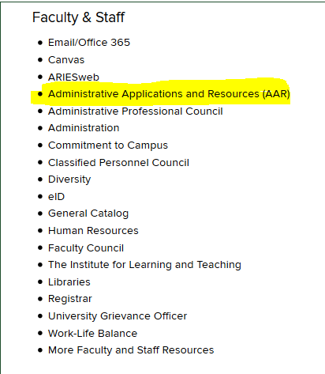
Log-On to the CSU Home Page

Slide 3
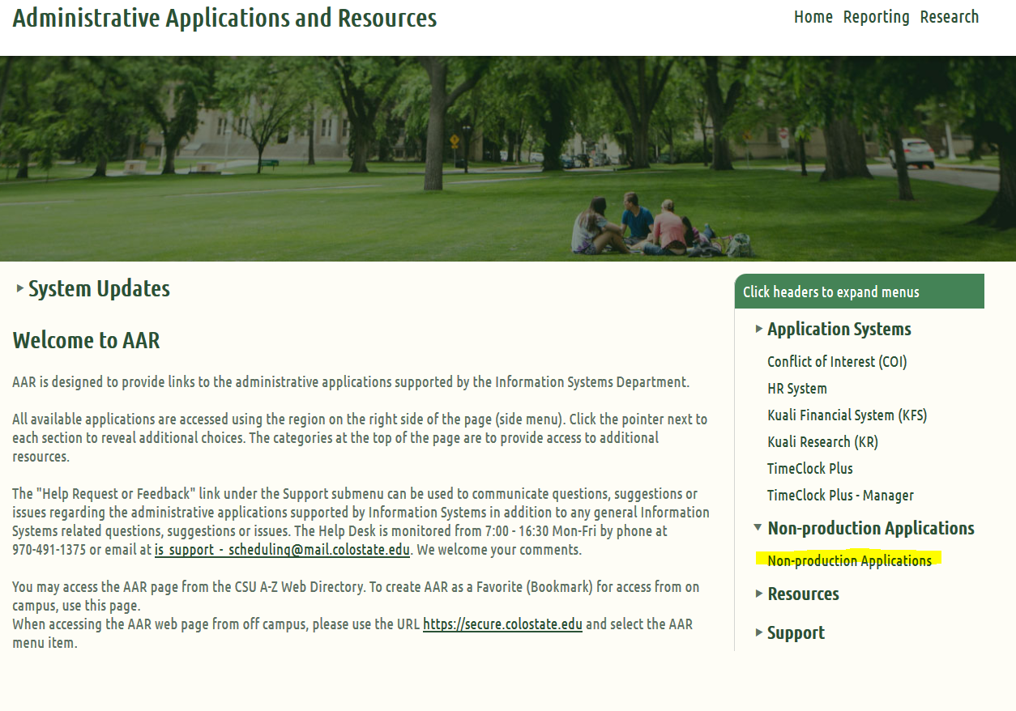
Click into the Training Site

Slide 4
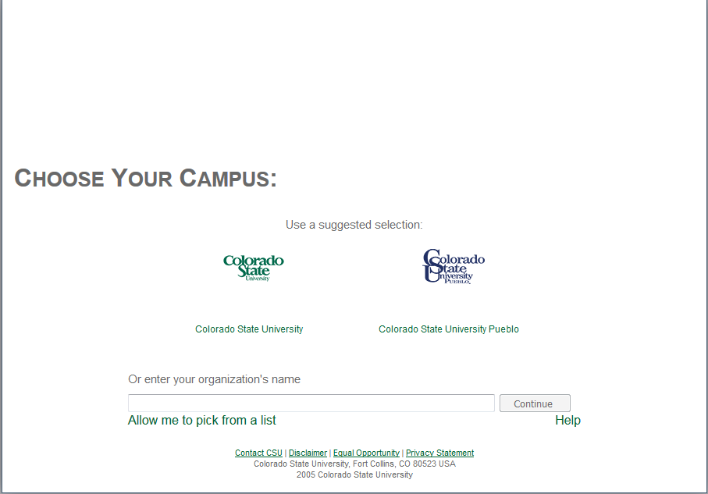
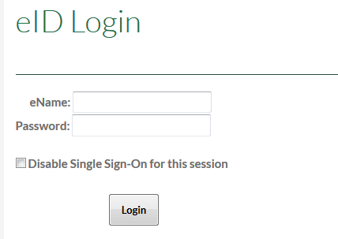
Sign into the Training Site
Choose your campus
Enter your EID and password
Click on: “Login”

Slide 5
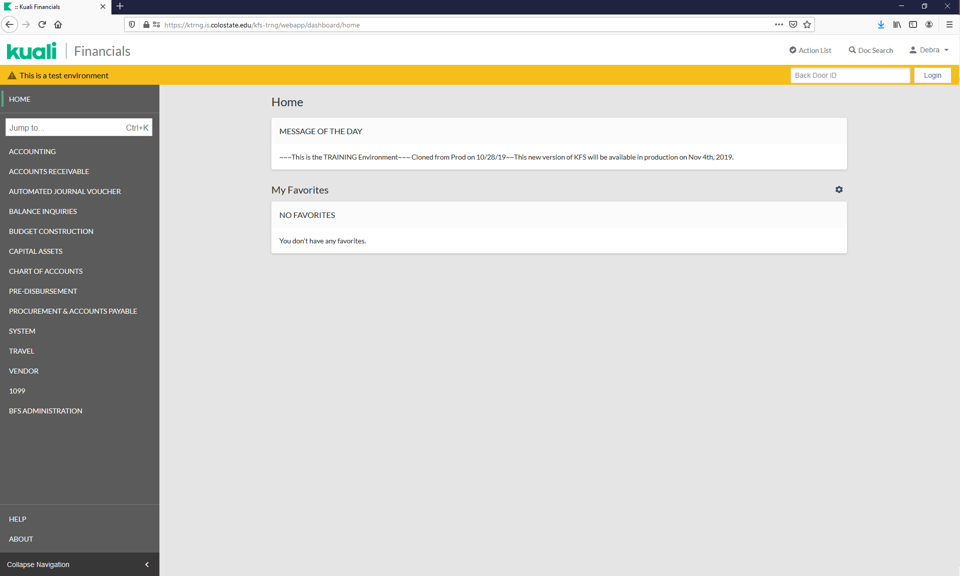
MAIN MENU

Slide 6
AGENDA
INFORMATION NEEDED PRIOR TO CREATING A GEC OR DI
FINDING INFORMATION
Purchase Order Lookup
Asset Lookup
Asset Payment Lookup
EXERCISES
FINANCIAL PROCESSING DOCUMENTS
General Error Correction
Modifying an Asset Example
Making Changes
Distribution of Income and Expense
Creating an Asset Example
Making Changes
QUESTIONS

Slide 7
INFORMATION NEEDED
The following information may be necessary or required when submitting a GEC or DI using a capital asset object code:
Correct Accounts (the account posted on the asset)
Correct Object Codes (cap and non-cap)
Correct Amounts (the amount posted on the asset)
Existing Asset Numbers (required when modifying assets)
Sub-Account (when needed)
Reference Origin Code (required on GEC’s, use 01)
Reference Number (required on GEC’s, recommend the PO #)
Line Description (asset description)
Vendor (required to create an asset, found on the PO)
Asset Information (required to create an asset; i.e. manufacturer, model, asset type code)
Asset Location (required to create an asset)
Notes:
It is important to know why you are submitting the document to know what is needed. Will you be modifying an existing asset (changing funding on an asset already created or expensing an asset that was created in error) or creating an asset (such as capitalizing a WIP or capitalizing an asset that was originally expensed).

Slide 8
FINDING INFORMATION
The PO is the best place to start to find information necessary for a GEC or DI.
Click on: Doc Search

Slide 9
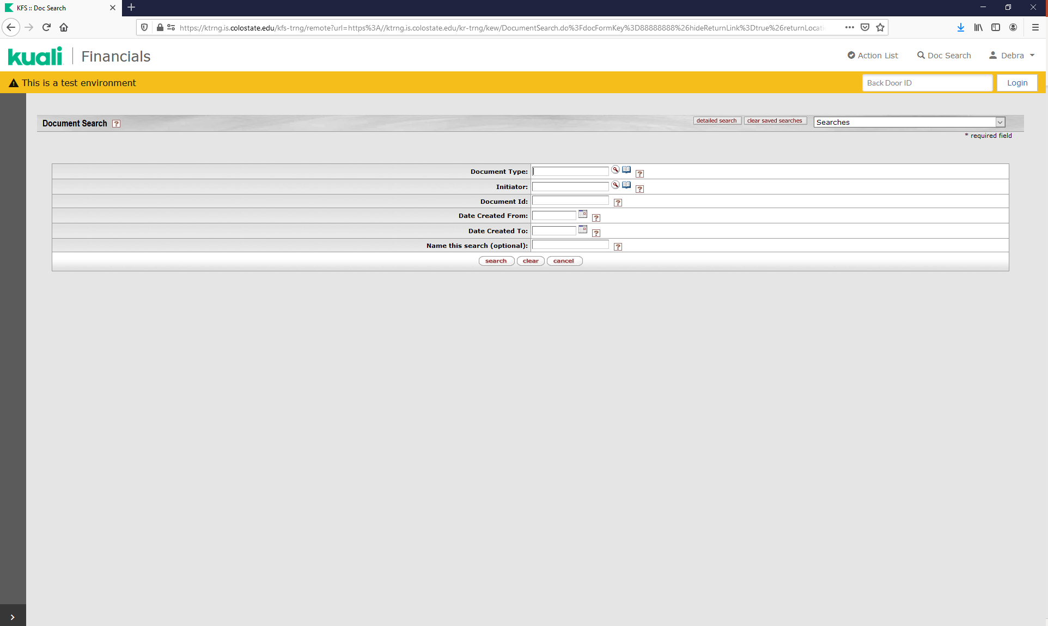
FINDING INFORMATION
Enter Document Type: “PO” then click anywhere on the search screen.

Slide 10
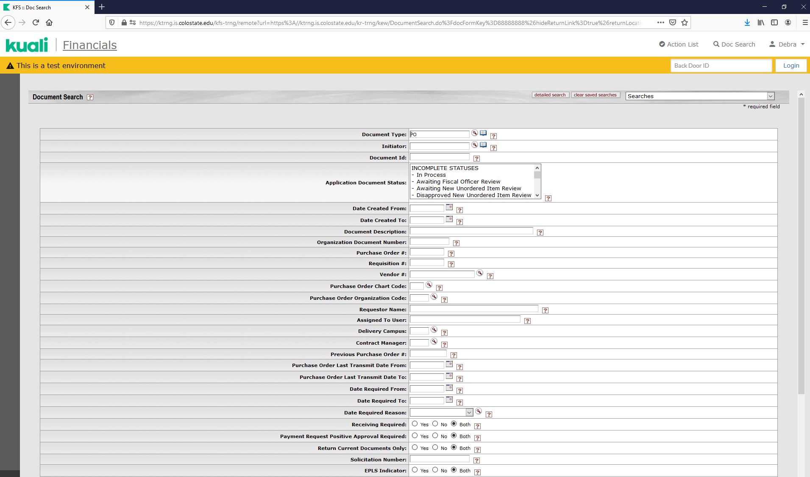
FINDING INFORMATION
The search will expand.
Search options include:
Date Created
Purchase Order Number
Requisition Number
Vendor
Account Number
Total Amount
And more…

Slide 11
FINDING INFORMATION
Enter PO Number: 548698
Click on: “search”

Slide 12
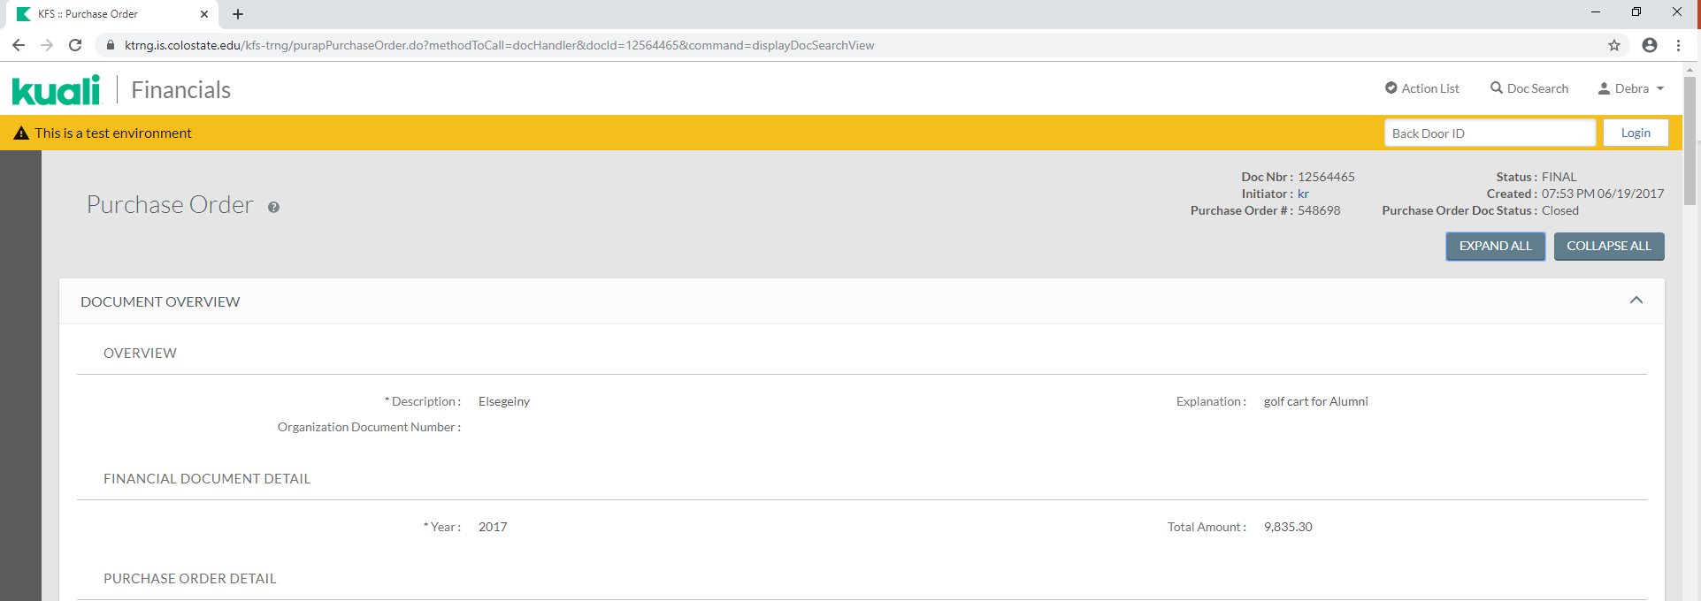
Purchase order lookup
You will see the following result:
If multiple results, click on the underlined Document Id for the closed PO.
This will open the Purchase Order document.
Click on the “collapse all” button.

Slide 13
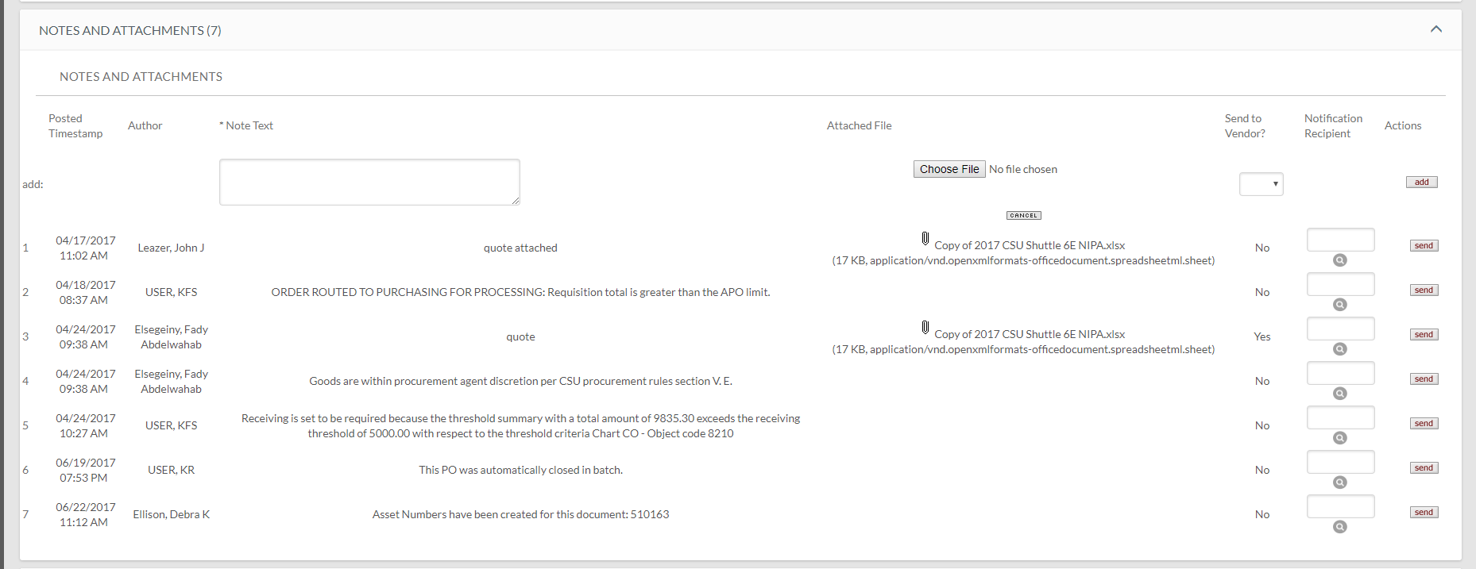
Purchase order lookup
Find the Notes and Attachments Tab and click on the “arrow”
Look in the Note Text for any asset numbers.
NOTE: If a PO was paid using a Disbursement Voucher, the asset number will not show up in the PO notes.

Slide 14
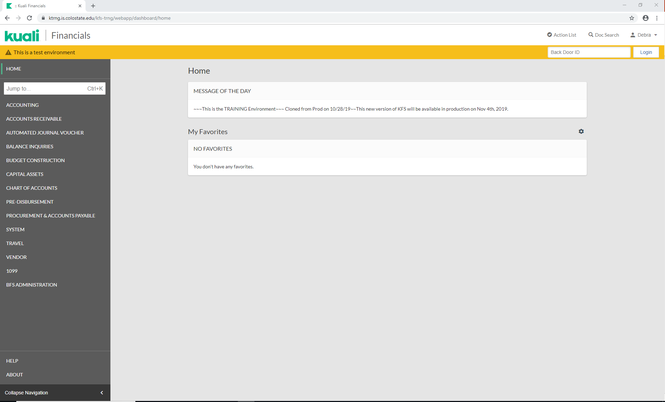
Home page
Click on “kuali” or the “Navigation Panel” to get back to the Home screen.

Slide 15
Asset and asset payment lookup
Click on Capital Assets in the Navigation Panel

Slide 16
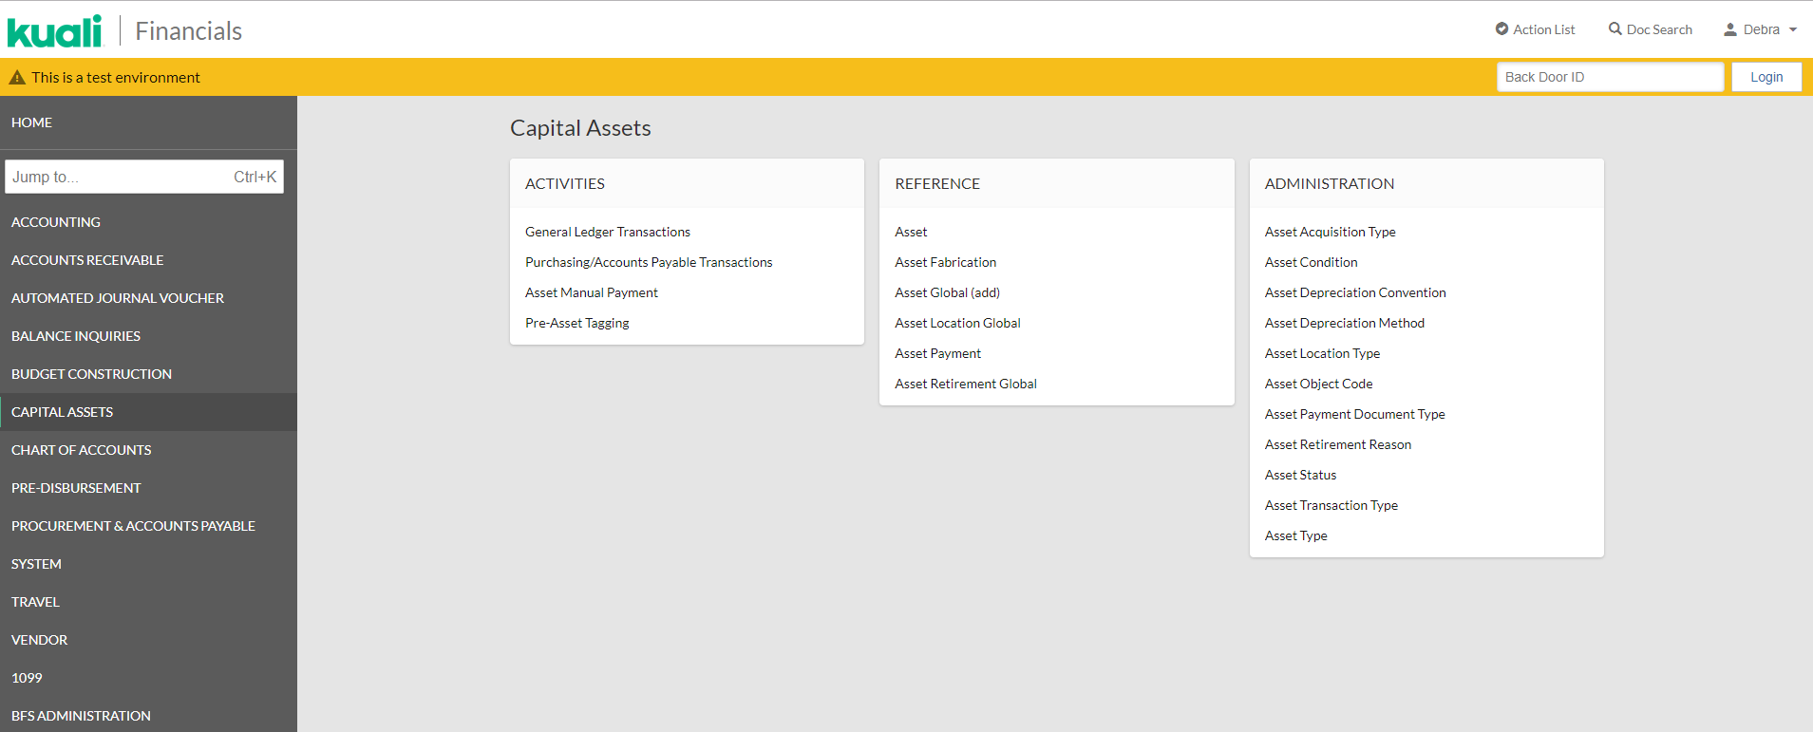
Asset lookup
You can use “Asset” or “Asset Payment” to find an asset number.
Asset search uses asset identifying information to find an asset.
Asset Payment uses payment identifying information to find an asset.
Click on “Asset”

Slide 17
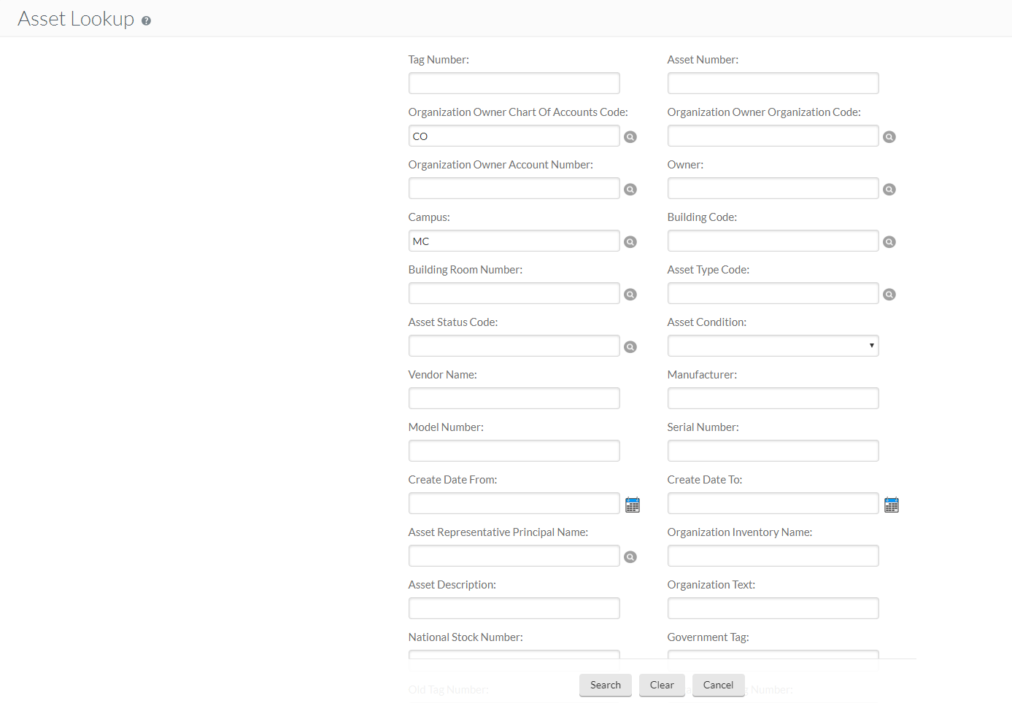
Asset lookup
Search options include:
Tag “Decal” Number
Vendor Name
Create Date
And any other asset related information…
Enter asset # 502408
Click on: “search”
This asset has one item retrieved.
Here you will find the asset number, tag (decal) number, organization owner organization code (department number), building code, asset status code, asset description, asset type code, and in-service date.
You can also move the results to a spreadsheet.
Click on: the underlined Asset Number.

Slide 18
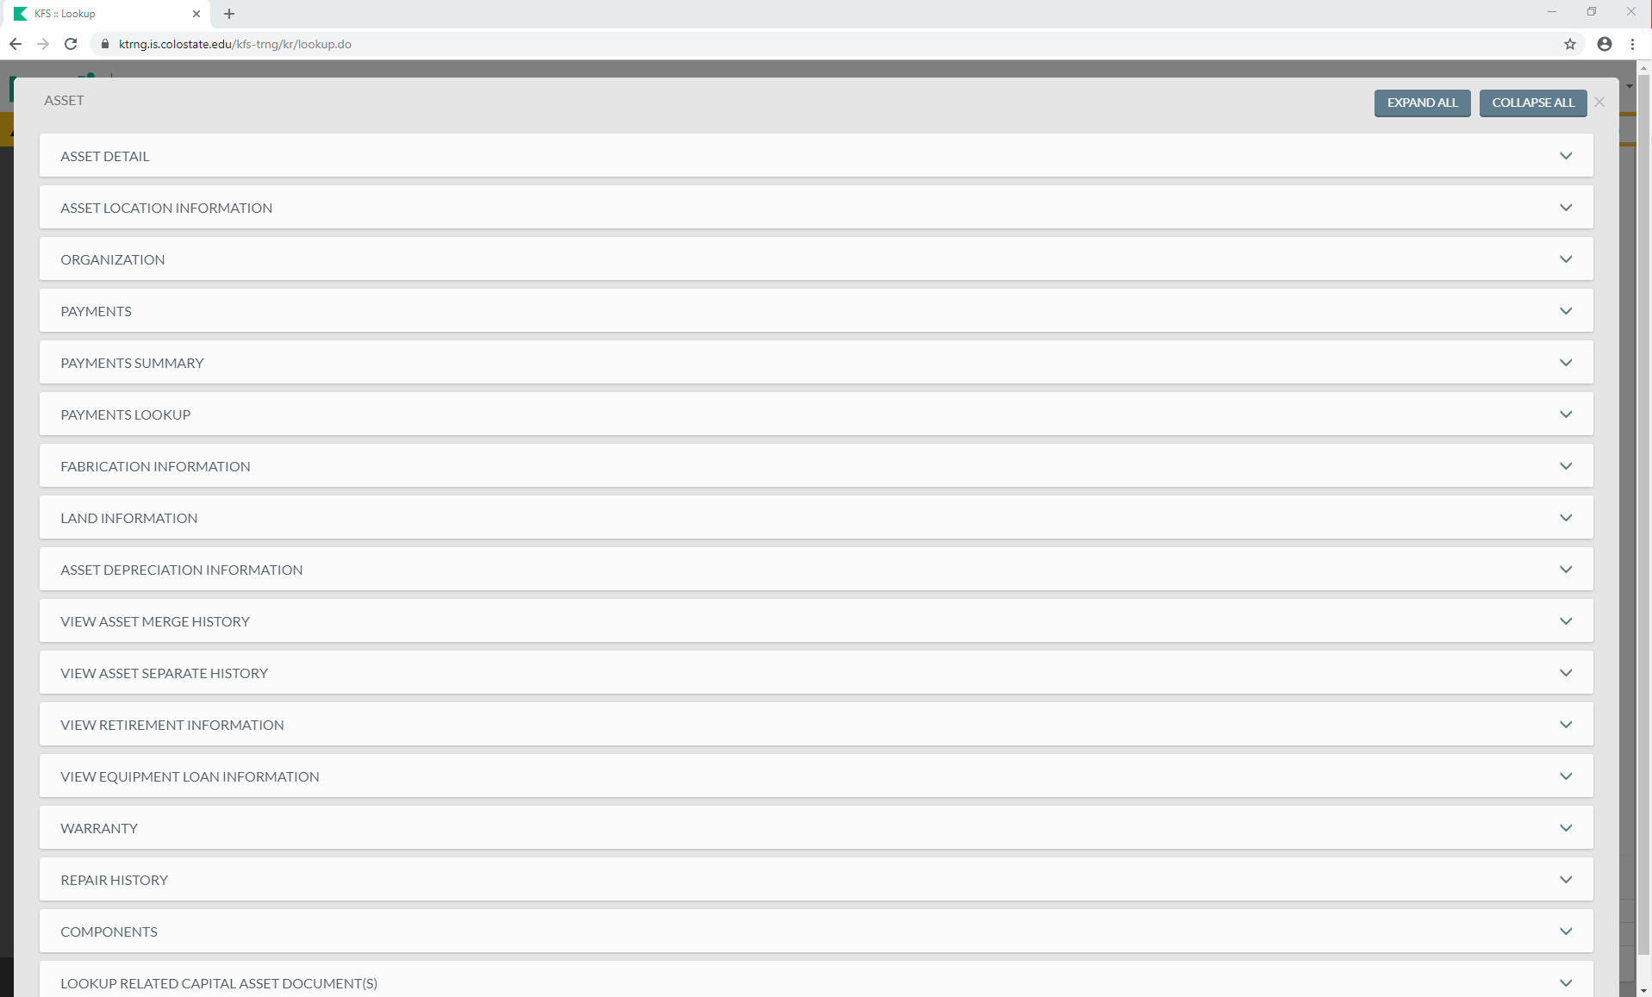
Asset lookup
The Asset Panel will be brought up.
Click on the PAYMENTS tab arrow.

Slide 19
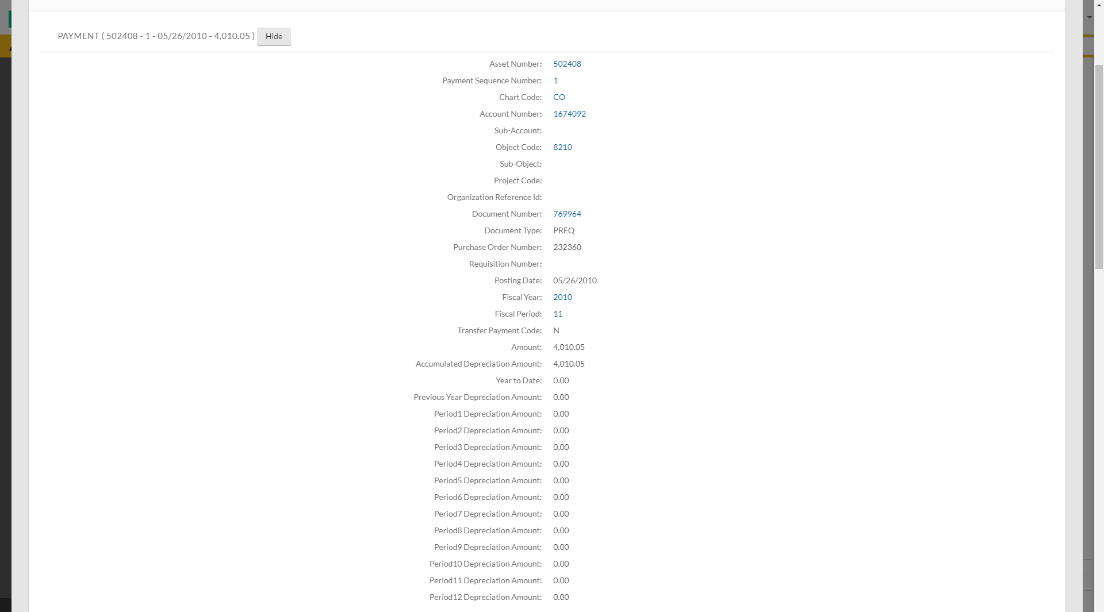
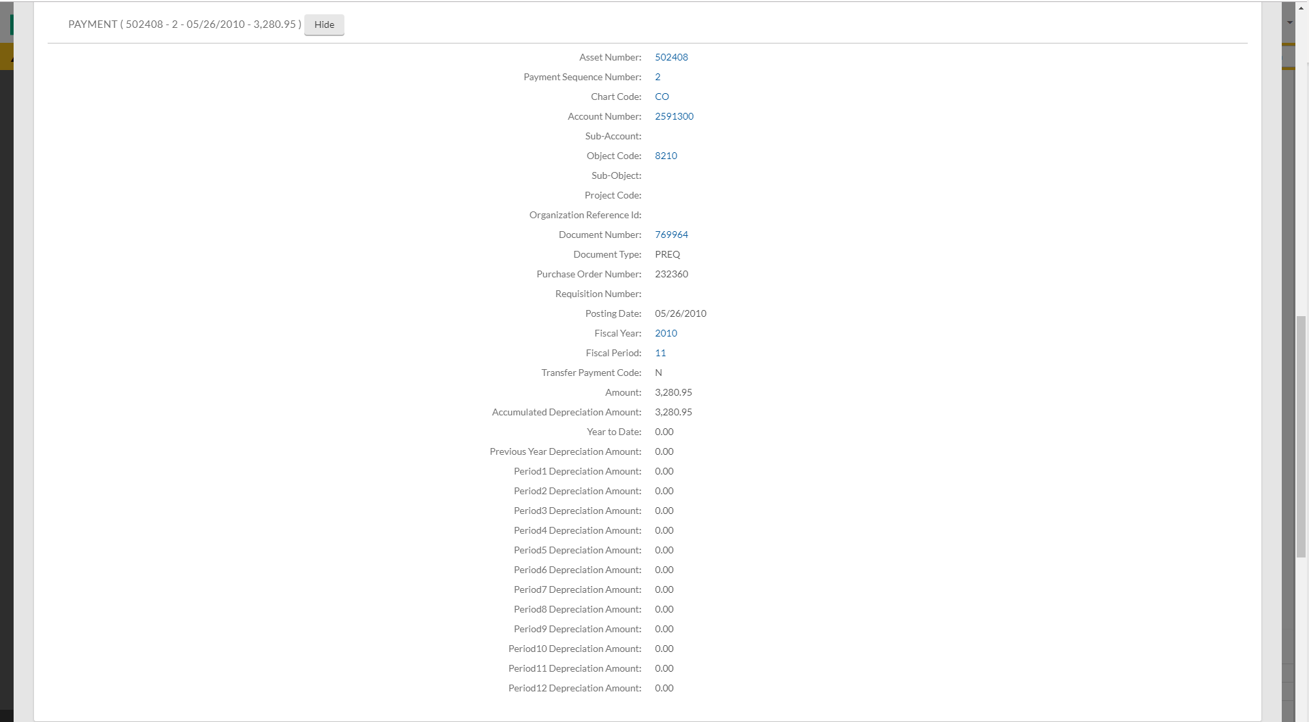
Asset lookup
This tab shows payment related information necessary for your GEC or DI when using Modify Existing.
There were two payment postings on this asset.

Slide 20
Asset lookup
You can see the Account Number and Object Code, the Source Document of the Posting, the Purchase Order Number, the Amount, and other information for each payment posting.

Slide 21
Asset lookup
You also have a PAYMENTS SUMMARY tab and a PAYMENTS LOOKUP tab.
The PAYMENTS SUMMARY tab shows the total amount of all the payments.
The PAYMENTS LOOKUP tab may need to be used if there are several postings on the asset record and they all can’t fit in the PAYMENTS tab.
Click on: “Click here”

Slide 22
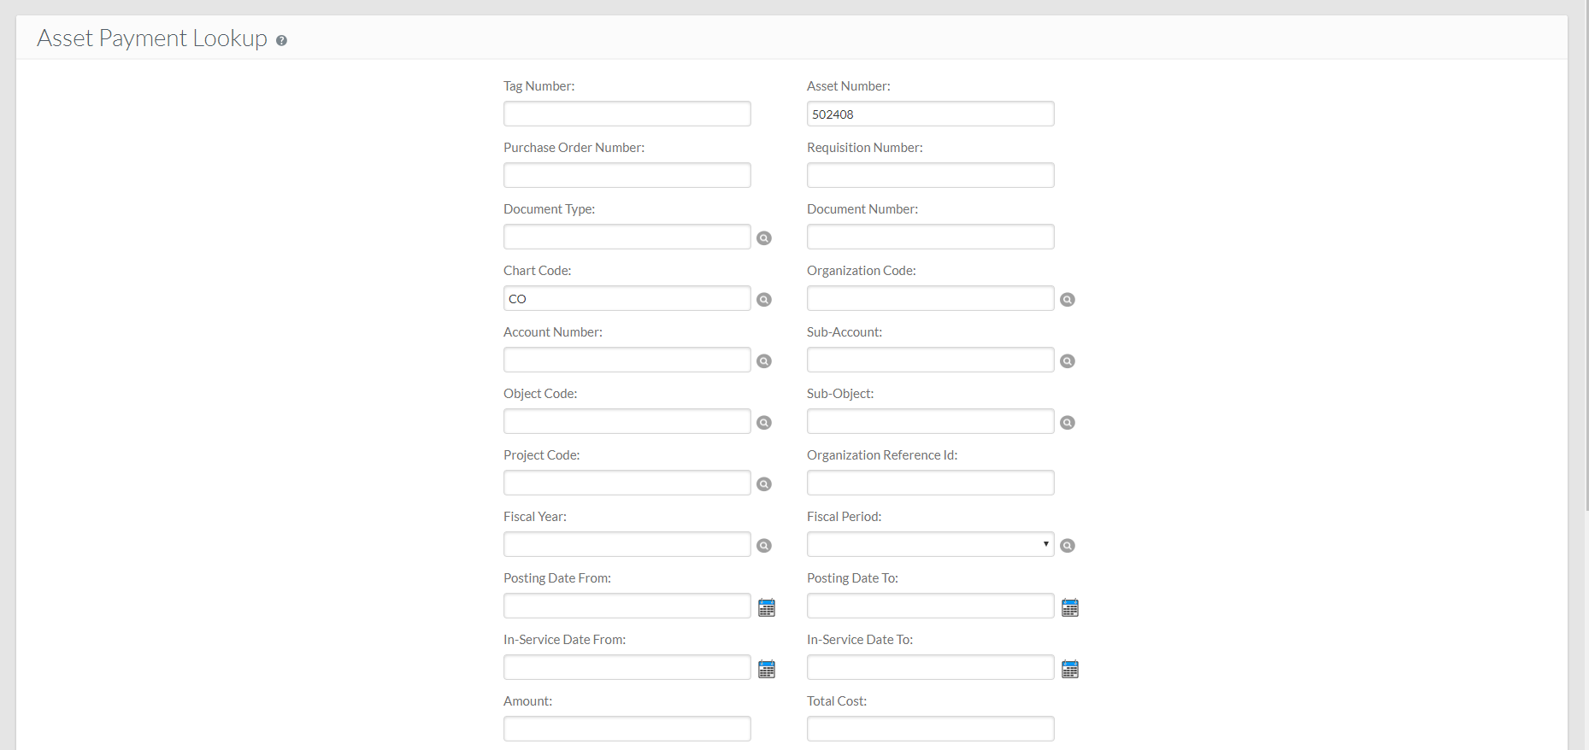
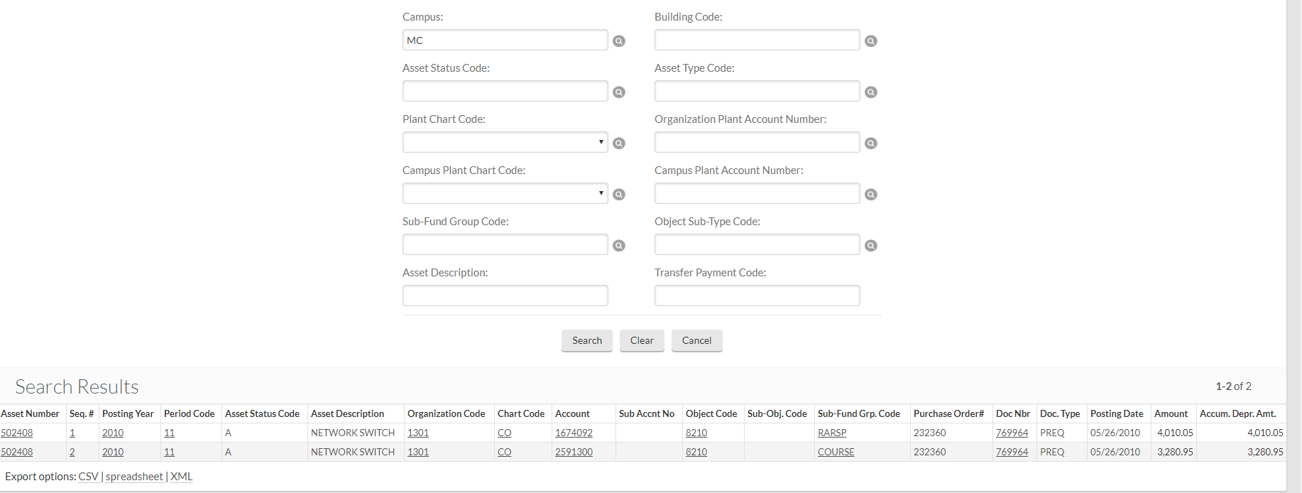
Asset lookup
This will take you to the Asset Payment Lookup screen.
To have the same view of each payment that is shown in the Payments Tab, click on the Seq. # for each account listed.

Slide 23
Asset PAYMENT lookup
Using “Asset Payment” to find information.
Click on Capital Assets in the Navigation Panel

Slide 24
Asset PAYMENT lookup
Click on “Asset Payment”

Slide 25
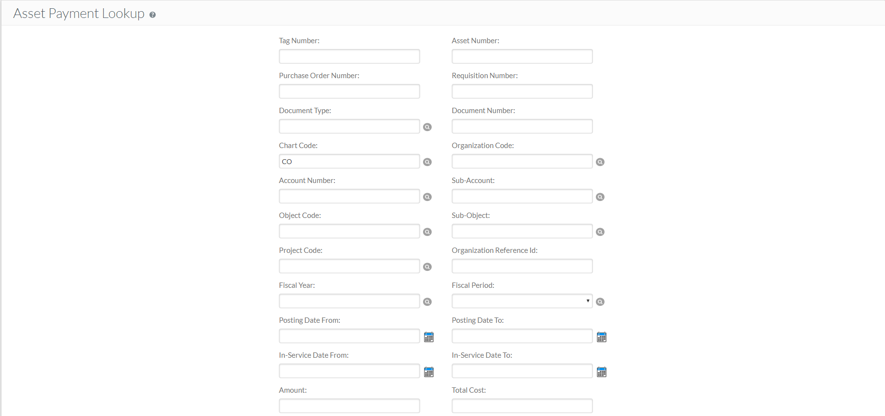
ASSET PAYMENT LOOKUP
Search options include:
Purchase Order Number
Account Number
Object Code
And more…
Enter asset # 502408
Click on: “search”
This asset has two items retrieved.
Here you will find the account number, object code, purchase order #, doc number, doc type, posting date, and amount.

Slide 26
exercises
Lookup what account(s) were used to purchase an asset from PO 413607?
5378110-8240 & 1313478-8210
How much did each account pay?
$12,836.62 (53) & $371.14 (13)
What is the asset number?
506836
How many “Active” assets are on account 1581340?
8 (active/watch for duplicate asset numbers and payment GEC’s zeroing out an account payment). The Asset Payment look up brings up all account postings on the asset, so an asset may have multiple postings on an account due to GEC’s etc.
How many assets did Department (Organization Code) 6030 purchase from in service date 07/01/2015 to in service date 07/31/2015?
5 (watch for duplicate asset numbers)

Slide 27
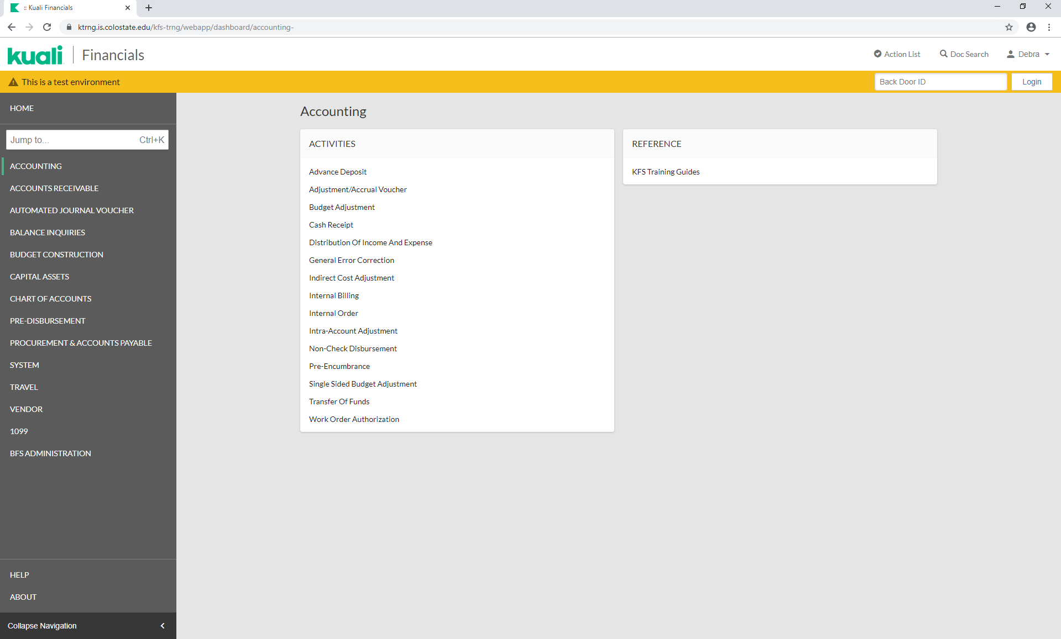
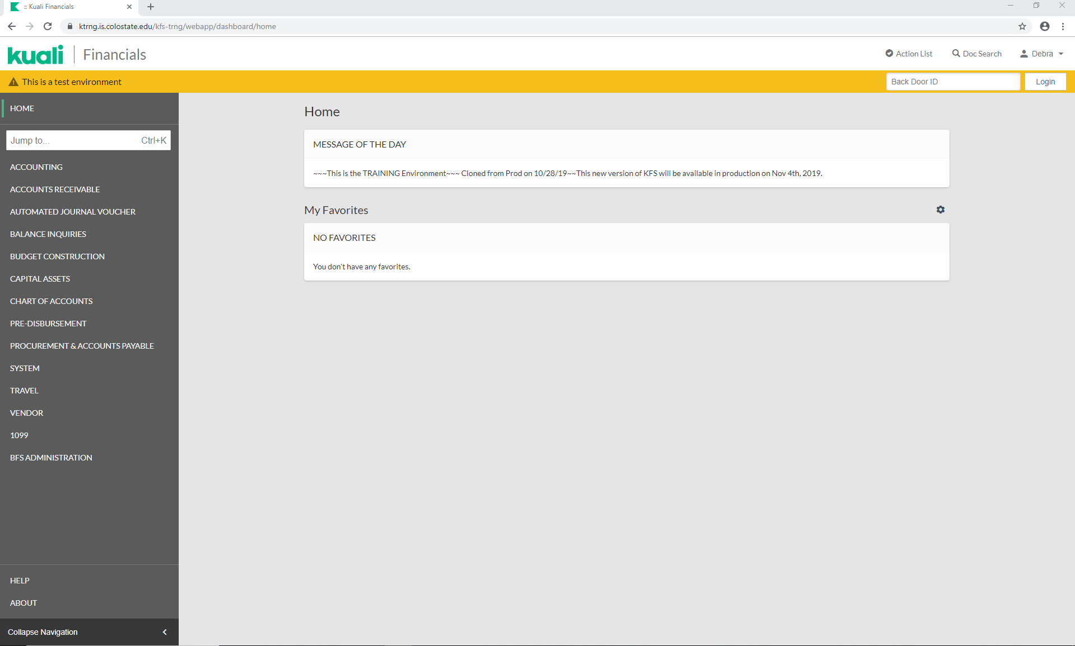
FINANCIAL PROCESSING DOCUMENTS
You will find the General Error Correction document and the Distribution of Income and Expense document.

Slide 28
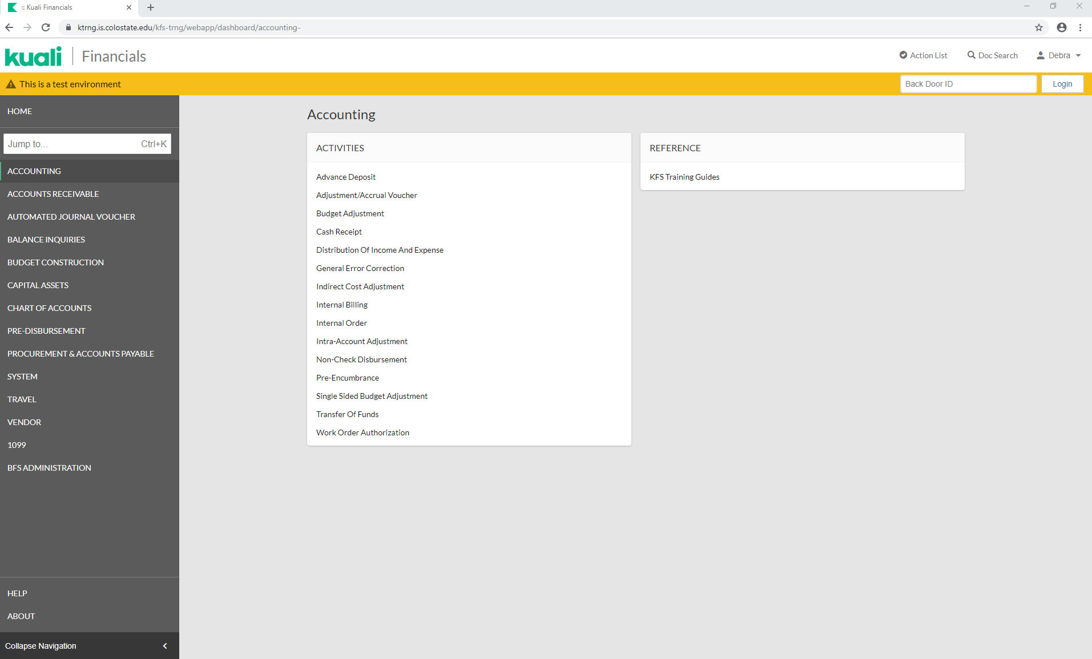
General error correction document
Cap to Cap will modify an existing asset.
Click on: General Error Correction

Slide 29
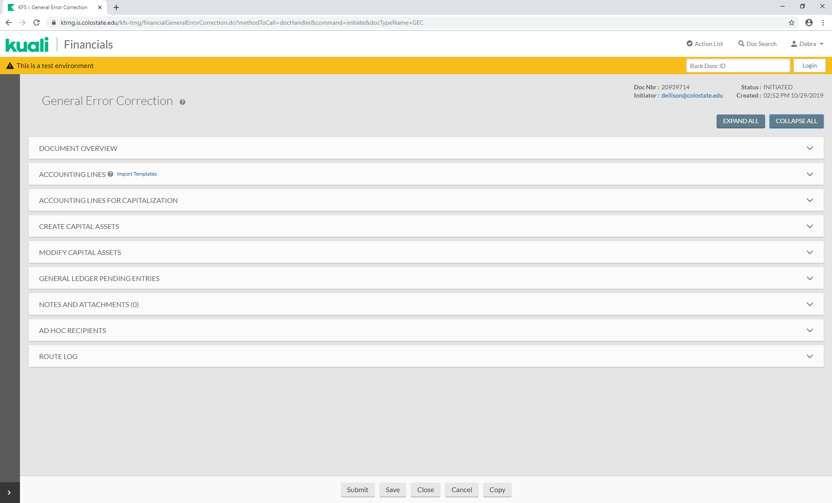
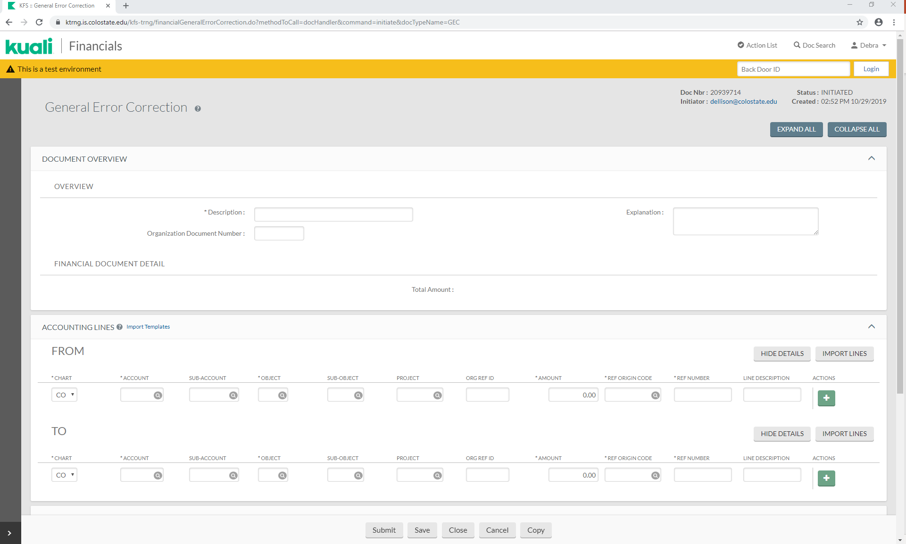
General error correction document
The GEC document will be brought up.
Click on the “COLLAPSE ALL” button.

Slide 30
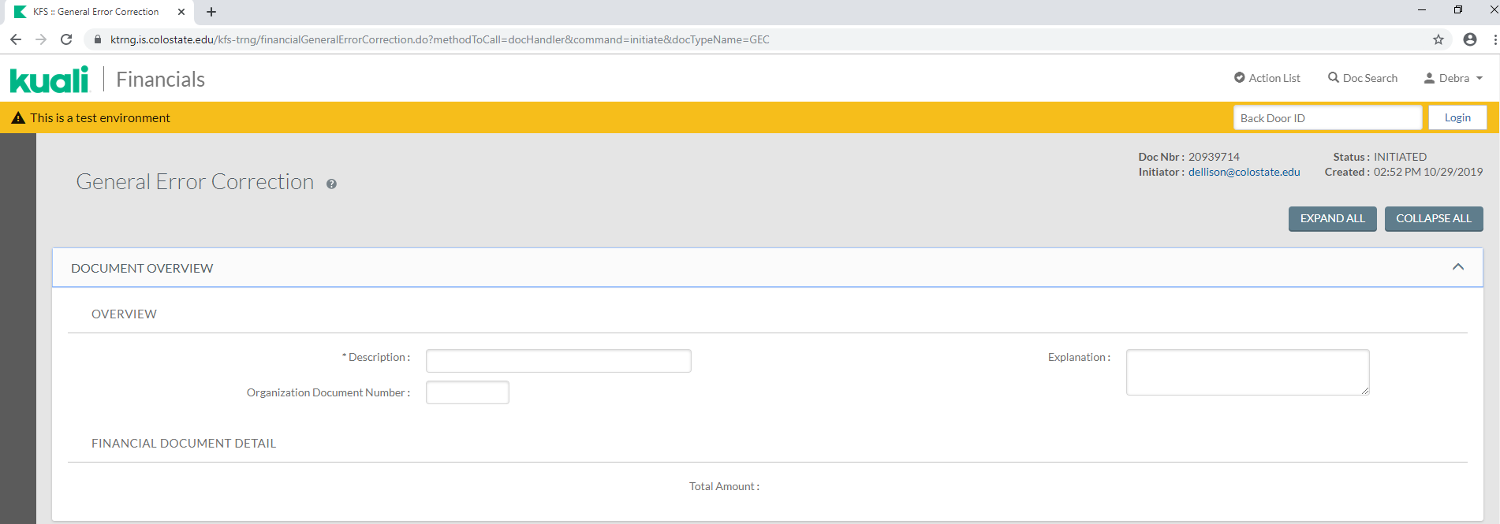
Document Overview tab
Click on the arrow for the DOCUMENT OVERVIEW tab.
The Document Overview Tab provides a place for the description, explanation (reason for the document), and the organization document number.

Slide 31
Document Overview tab
Description: Enter “Test”.
Explanation: Enter any necessary information (i.e. Funding Change)
Organization Document Number: Enter the PO number 527965

Slide 32
Accounting Lines TAB
The Accounting Lines Tab is where you enter your credit (from/source) and debit (to/target) information.

Slide 33
Accounting Lines TAB
When entering accounting lines, do not line item out separate amounts on identical accounts and object codes.
Instead, combine identical accounting lines into one line for the total amount.

Slide 34
ACCOUNTING LINES TAB
FROM/SOURCE:
Account Number: 1337440
Object: 8210 (cap)
Amount: $10,000
Reference Origin Code (not listed on the DI): 01
Reference Number (not listed on the DI): 527965 (PO Number)
Line Description: GEL IMAGING SYSTEM
Click on: “add”

Slide 35
ACCOUNTING LINES TAB
TO/TARGET:
Account Number: 1369540
Object: 8210 (cap)
Amount: $10,000
Reference Origin Code (not listed on the DI): 01
Reference Number (not listed on the DI): 527965
Line Description: GEL IMAGING SYSTEM
Click on: “add”

Slide 36
If an Accounting Line has a capital asset object code, the Accounting Lines for Capitalization Tab will show up.
ACCOUNTING LINES TAB
Click on: “generate”.

Slide 37
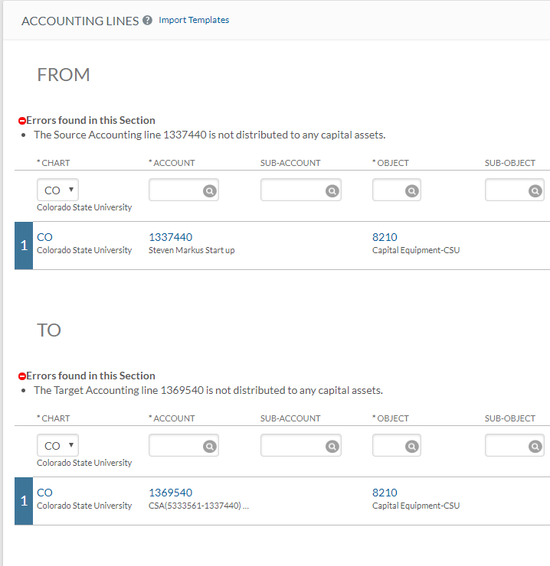
ACCOUNTING LINES TAB
Once open, an error message will occur in any Accounting Lines section that contains a capital asset object code.

Slide 38
ACCOUNTING LINES FOR CAPITALIZATION TAB
Determine which account to select.
You can select one account at a time or multiple accounts at a time, depending upon what you are needing to do.
Select both lines.

Slide 39
ACCOUNTING LINES FOR CAPITALIZATION TAB
Select Amount Distribution Method
Distribute cost evenly will divide the amount equally among all assets.
Distribute cost by amount allows for different amounts per asset.
Select Distribute cost evenly.

Slide 40
Select if you are creating an asset or modifying an existing asset.
ACCOUNTING LINES FOR CAPITALIZATION TAB
Create asset is used to create a new asset or assets. Selecting create asset will require you to complete the Create Capital Assets Tab.
Modify asset is used to apply the posting to an existing asset or assets. Selecting modify asset will require you to complete the Modify Capital Assets Tab.
Click on: “modify asset”.

Slide 41
Modify CAPITAL ASSETS TAB
The Modify Capital Assets tab will open.
Enter the Asset Number (not the decal number).
If you don’t know the asset number, use the asset lookup page.
Click on: one of the two available magnifying glasses.

Slide 42
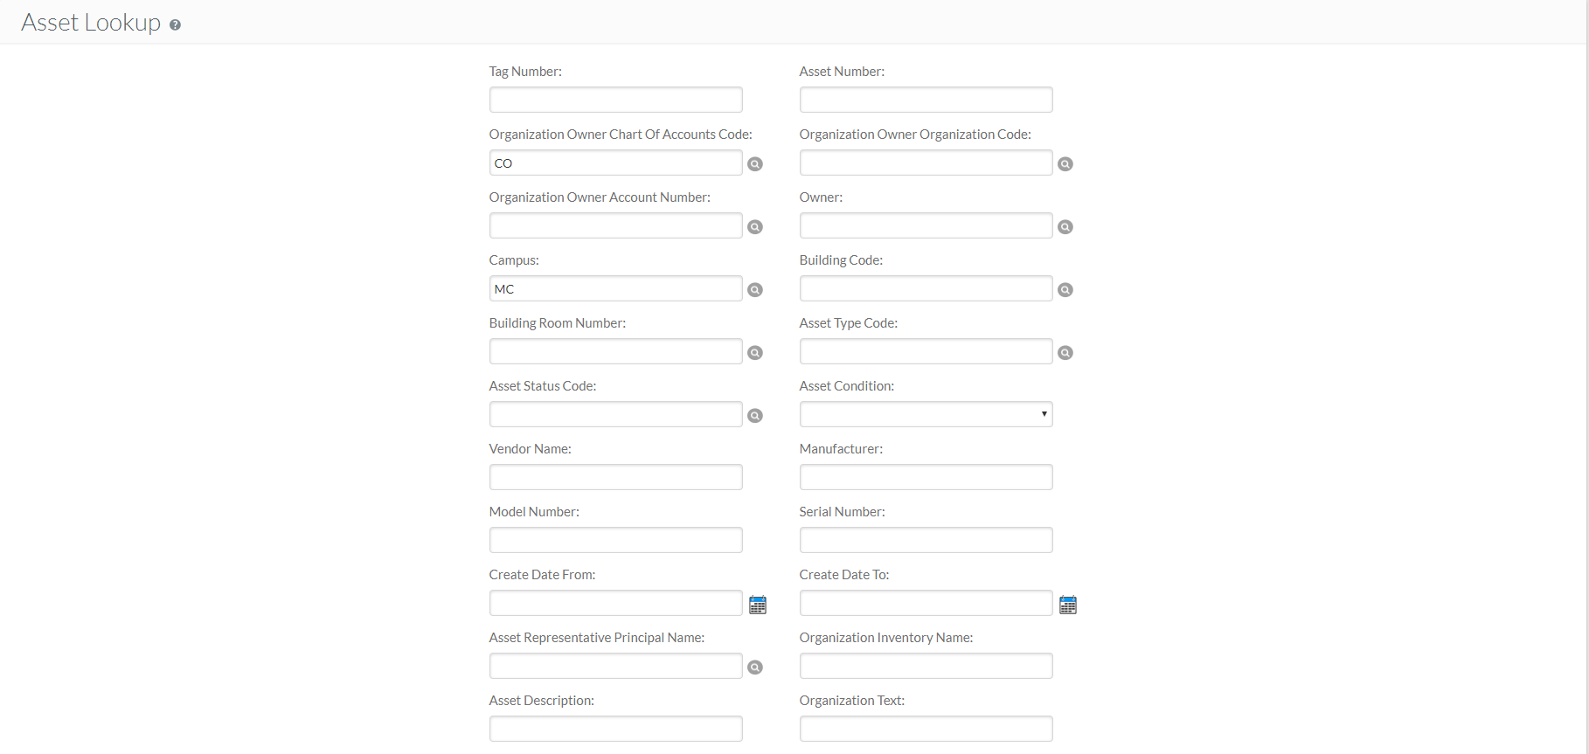
Asset lookup
The Asset Lookup tab will open.
Use known information to find the asset number.
Enter the Tag/Decal Number
Asset Description “Gel Imaging System” (use wild cards “*”)
Purchase PO Number “527965”
ETC.

Slide 43
Asset lookup
Enter PO 527965
Click on: “search”
Click on: “return value”.

Slide 44
Modify CAPITAL ASSETS TAB
The Asset Number will now be populated.
The Source, Target, and Asset should now reflect the amounts to be distributed.
The System Control Remainder Amount should show “0.00”.
The System Control Remainder Amount will need to be distributed to the Source, Target, and Asset. NOTE: Kuali does not distinguish debits and credits.
Click on: “redistribute total amount”.
Notes:
NOTE: Kuali does not distinguish between debits and credits (it uses “to/from” or “source/target”), so you will see the total amount of your line items in the System Control Amount.

Slide 45
NOTES AND ATTACHMENTS TAB
Attach any backup in the Notes and Attachments Tab and click on “add”.
You can now submit, save, reload, close, cancel or copy the document.
Click on: “save”.

Slide 46
MAKING CHANGES
Once information has been entered, the following Actions are available:
Refresh, will update any amount changes.
Delete, will delete all info in the section.
Clear, will clear the amounts.
Click on: “clear”

Slide 47
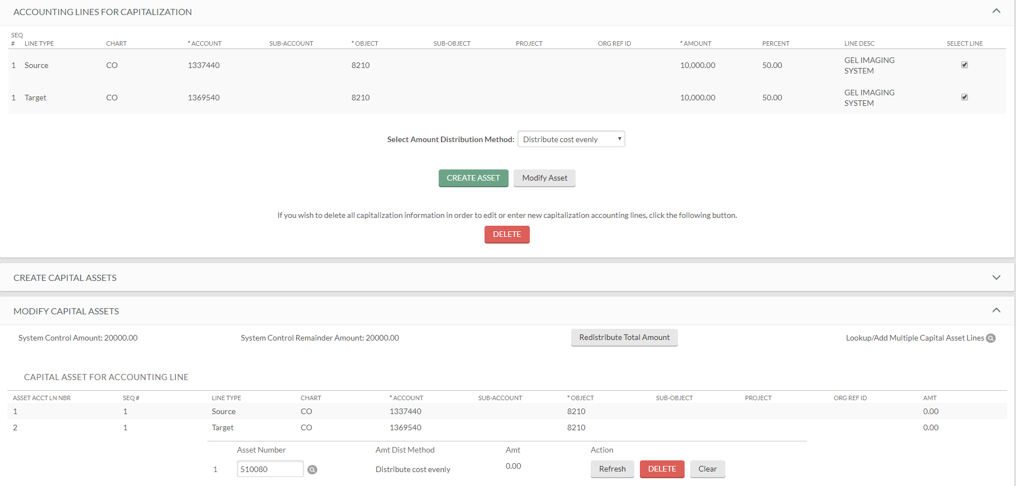
MAKING CHANGES
The amounts are back to zero and the System Control Remainder Amount is repopulated.

Slide 48
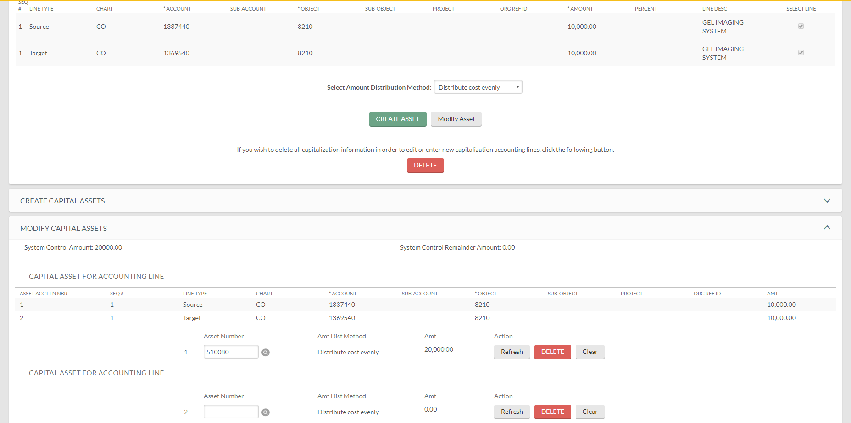
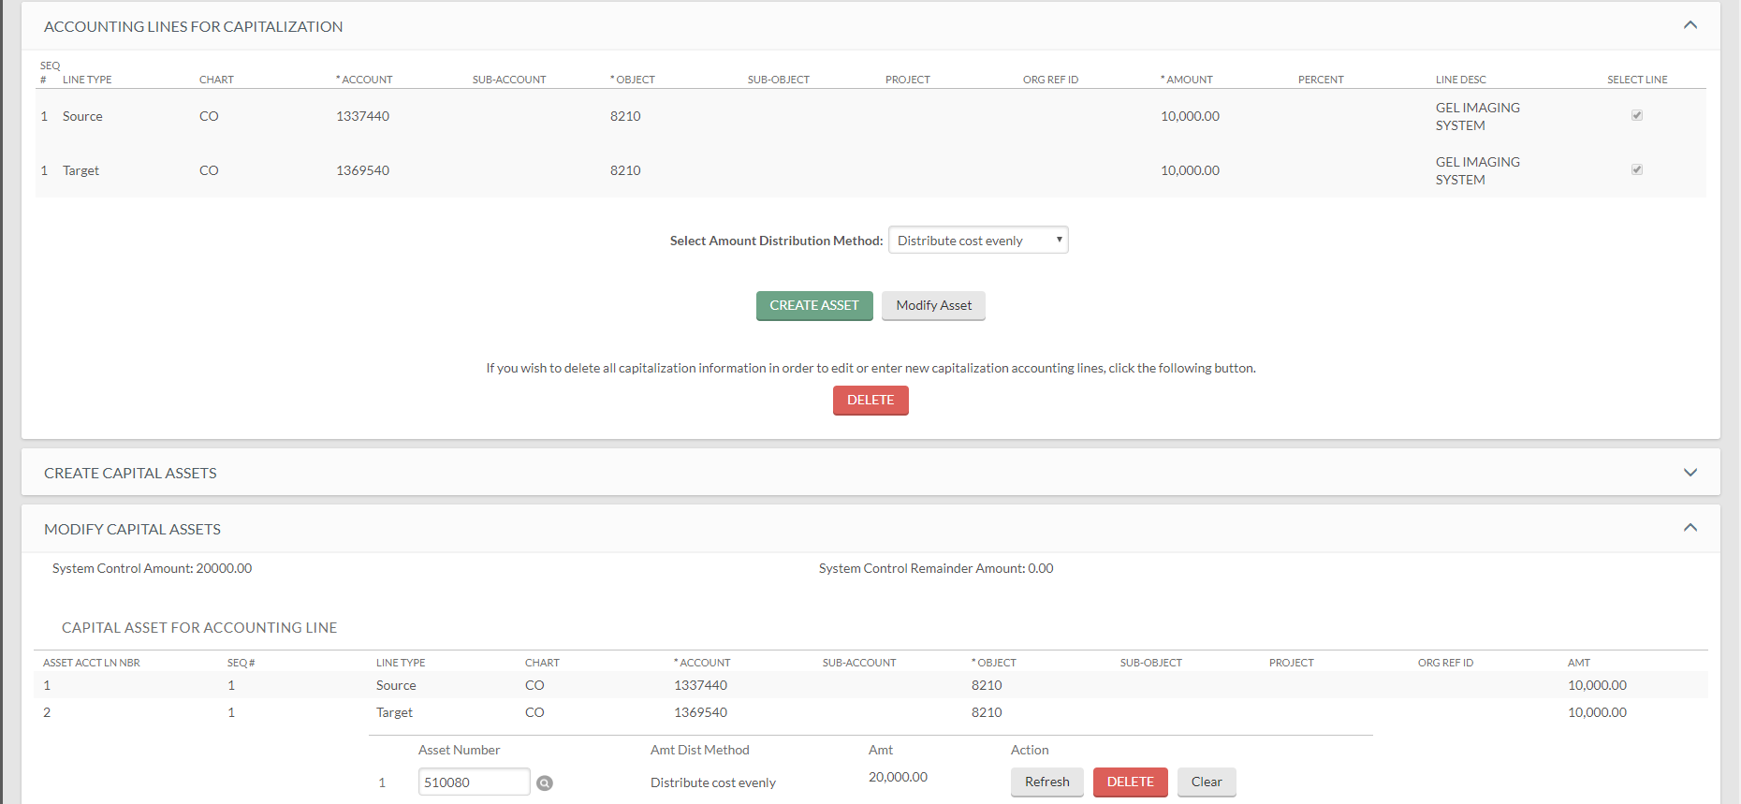
MAKING CHANGES
To add an additional asset, click on: “modify asset” again.
This opens up another section to enter another asset number.
The section will be removed.
To remove a section, click on: “delete”.

Slide 49
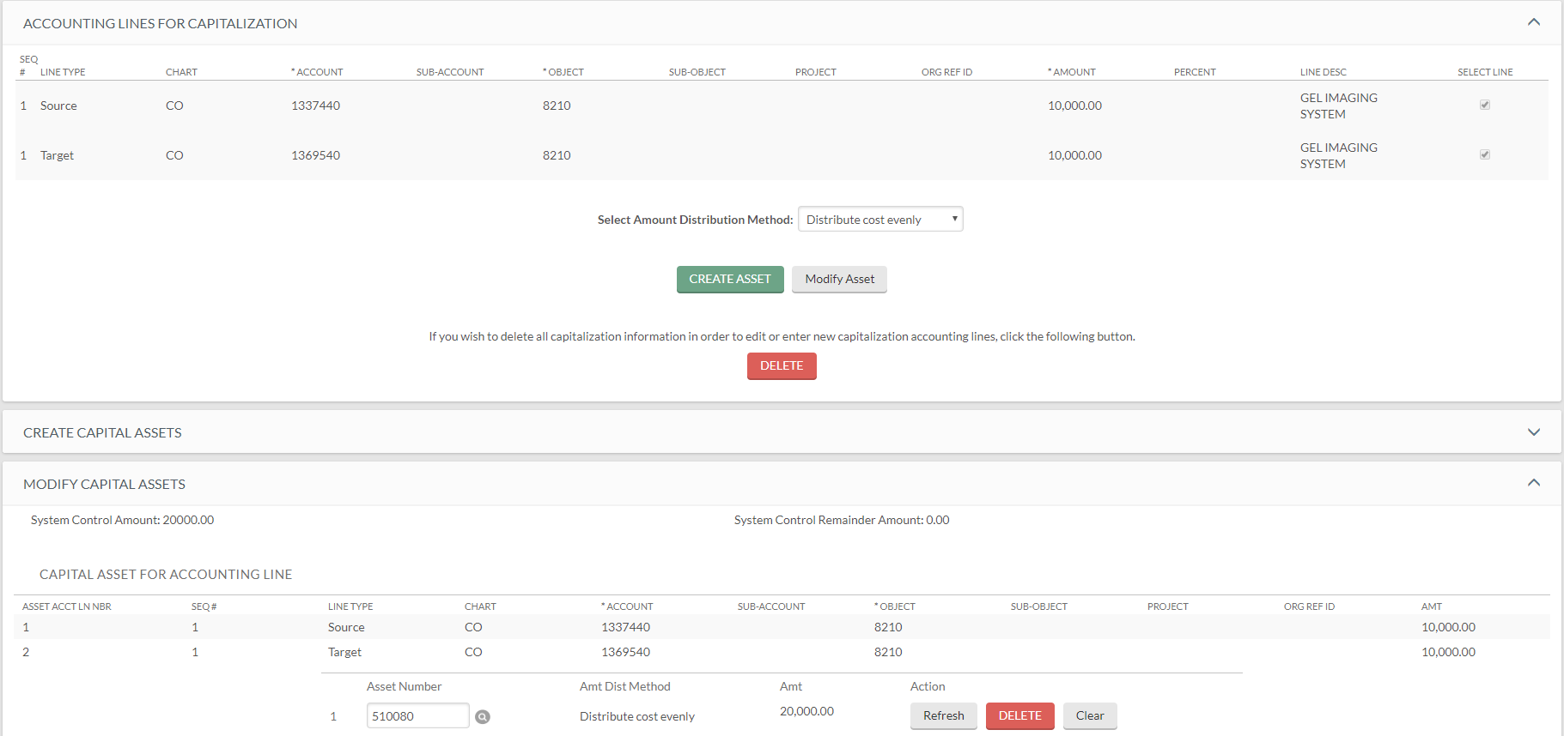
MAKING CHANGES
If you have made changes, but have not saved your document, click on: “reload”.
When you are done entering information, Click on: “submit”.
This brings your document back to the status prior to your changes and up to the last time you saved the document.

Slide 50
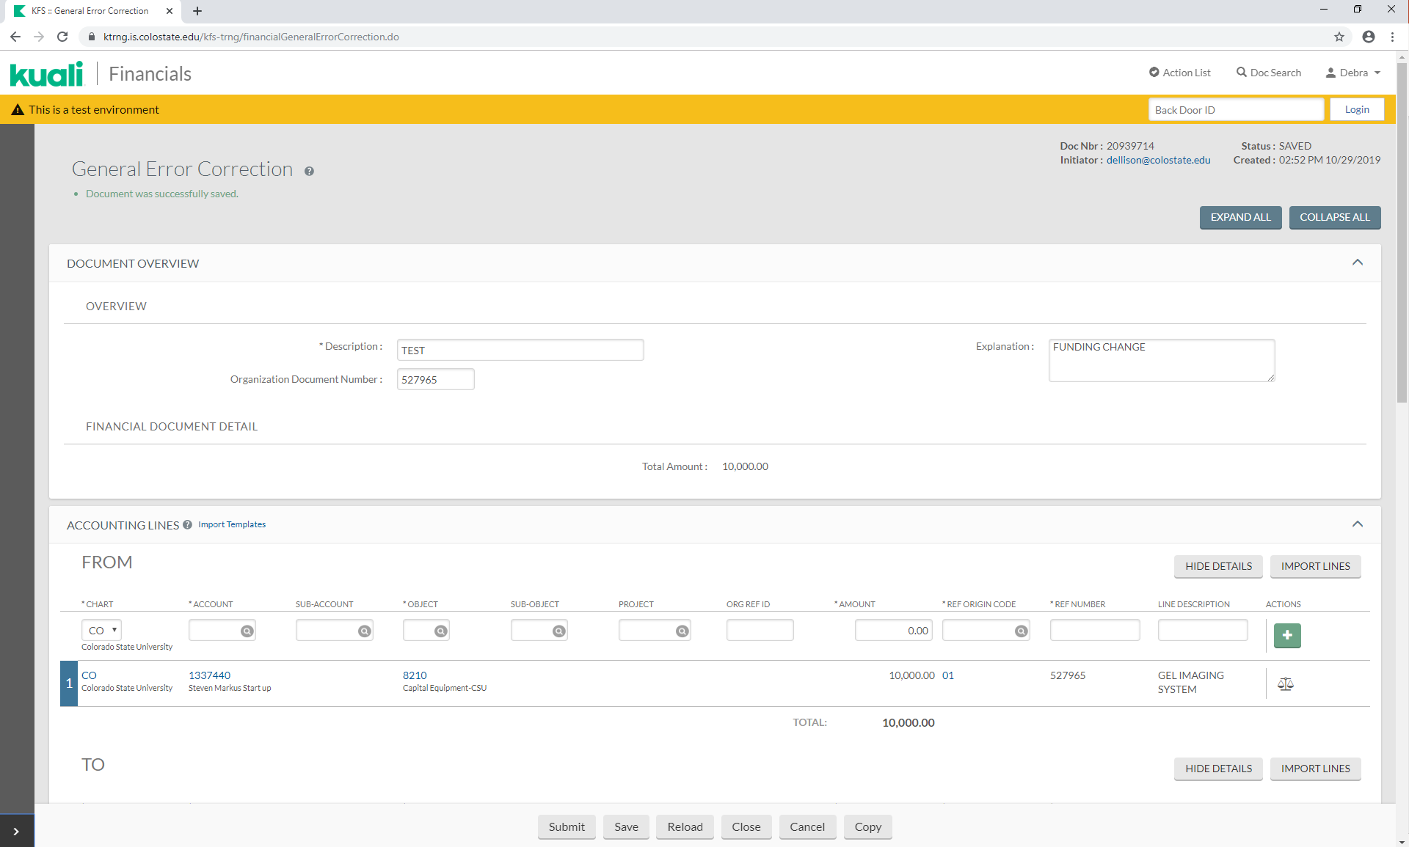
FINANCIAL PROCESSING DOCUMENTS
To go back to the Home Page, click on “kuali” or “expand the navigation panel”.

Slide 51
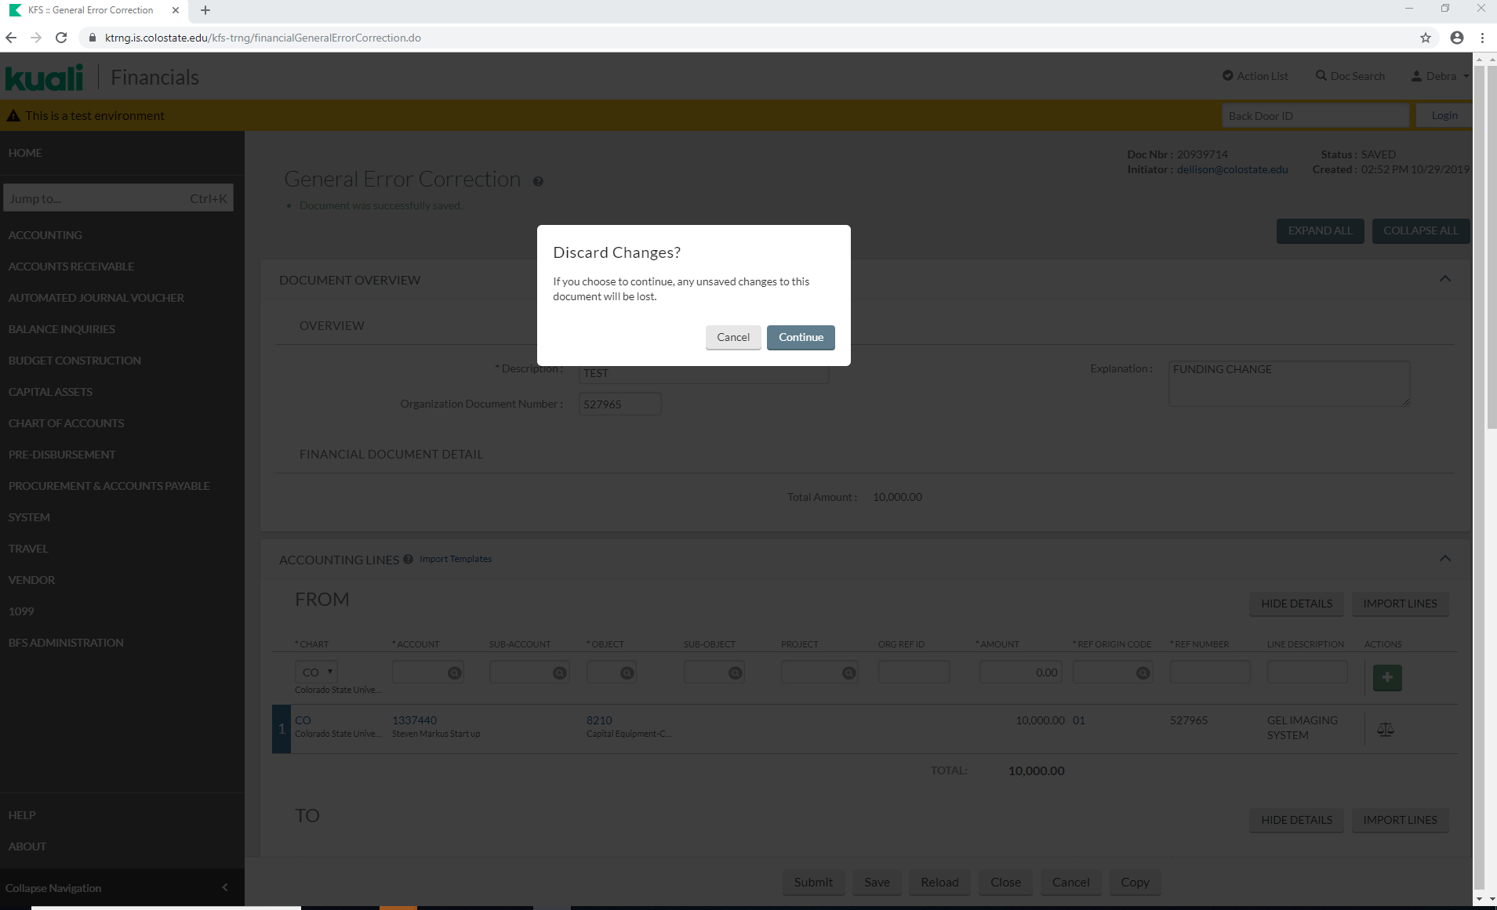
FINANCIAL PROCESSING DOCUMENTS
You will get a warning message regarding unsaved changes, click on “Continue”.

Slide 52
FINANCIAL PROCESSING DOCUMENTS

Slide 53
DISTRIBUTION OF INCOME DOCUMENT
Non-Cap to Cap will either create an asset or modify an existing asset.
Click on: Distribution of Income and Expense

Slide 54
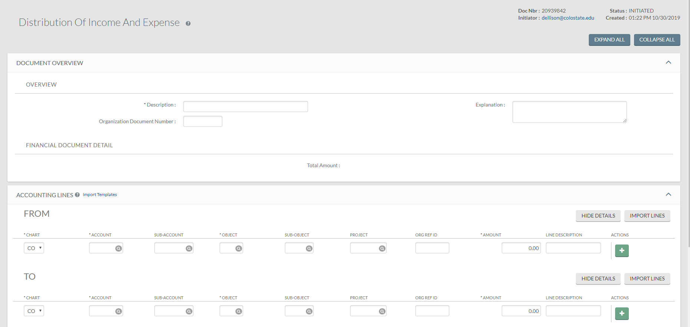
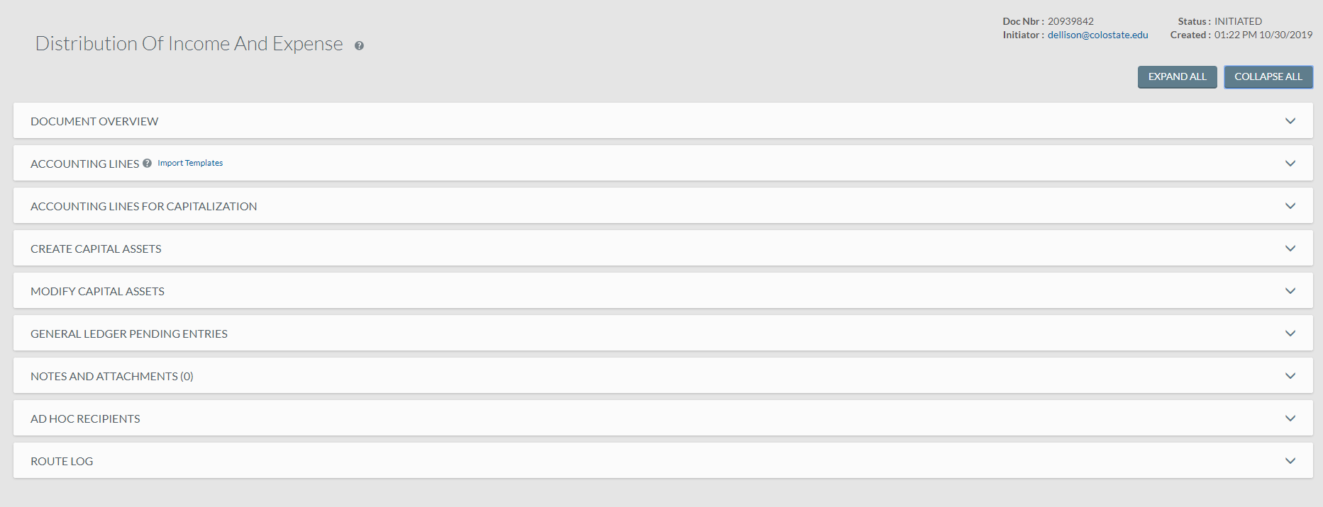
DISTRIBUTION OF INCOME DOCUMENT

Slide 55
Document Overview tab
Click on the arrow
Description: Enter “Test”.
Explanation: Enter any necessary information (Correcting object code from non-cap to cap in order to create two assets).
Organization Document Number: Enter the PO number 532294.

Slide 56
Accounting Lines TAB
FROM/SOURCE:
Account Number: 7724521
Object Code: 8905 (non-cap)
Amount: $17,377.00
Line Description: Equipment
Click on: “add”

Slide 57
Accounting Lines TAB
TO/TARGET:
Account Number: 7724521
Object: 8910 (cap)
Amount: $17,377.00
Line Description: Equipment
Click on: “add”

Slide 58
If an Accounting Line has a capital asset object code, the Accounting Lines for Capitalization Tab will show up.
ACCOUNTING LINES TAB
Click on: “generate”.

Slide 59
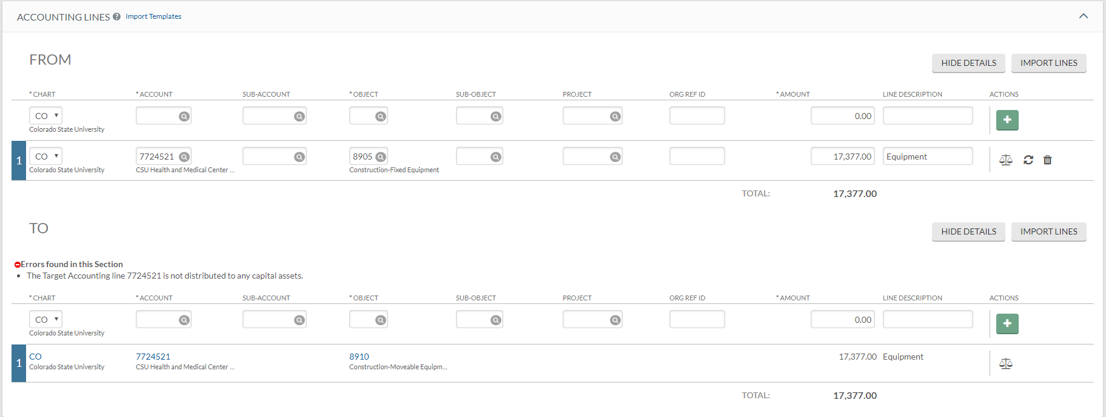
ACCOUNTING LINES TAB
Once open, an error message will occur in any Accounting Lines section that contains a capital asset object code.

Slide 60
ACCOUNTING LINES FOR CAPITALIZATION TAB
Complete the Accounting Lines for Capitalization Tab.
Select the Target line to distribute.
Select Distribute cost by amount.
Click on: “create asset”.

Slide 61
CREATE CAPITAL ASSETS TAB
The Create Capital Assets tab will open.
Enter the following:
Asset Quantity: 1
Asset Type (use the magnifying glass, if needed): 91040SI
Vendor Name (can only be entered by using the magnifying glass):
Lookup “Henry Schein Inc”
Manufacturer: AIRTEC
Model: V5
Amount (since Distribute cost by amount was selected): $8,822.00
Asset Description: Mojave Dry Vacuum System
Click on: “add tag/location”

Slide 62
CREATE CAPITAL ASSETS TAB
This will open a new section.
The Tag Number and Serial Number may be left blank, however, the Asset Location is required.
Enter the following:
Campus Code: MC
Building Code: 0116
Room Number 1027

Slide 63
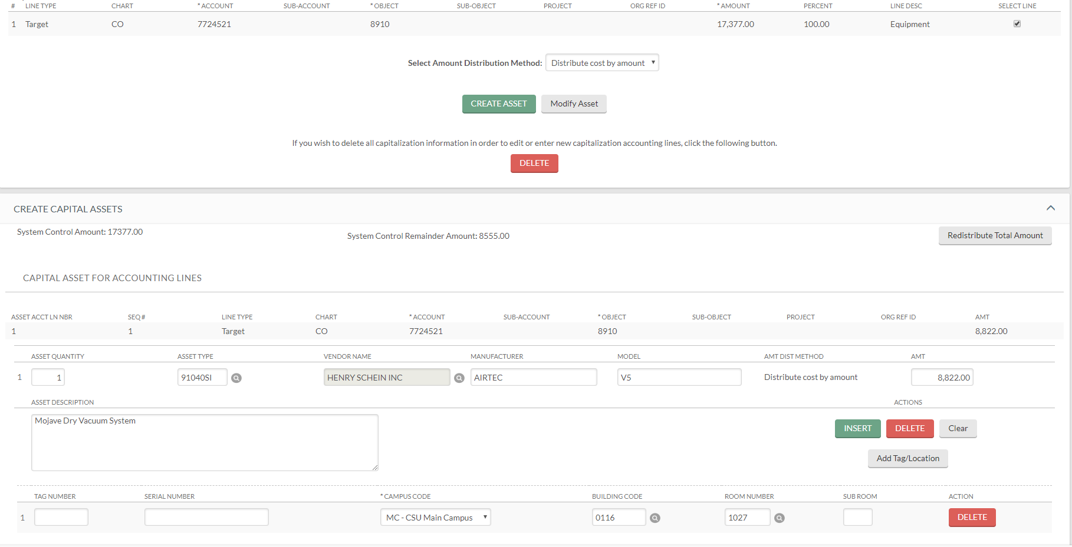
CREATE CAPITAL ASSETS TAB
The System Control Remainder Amount should reflect the remaining balance.
To create another asset, repeat click on: “create asset”.

Slide 64
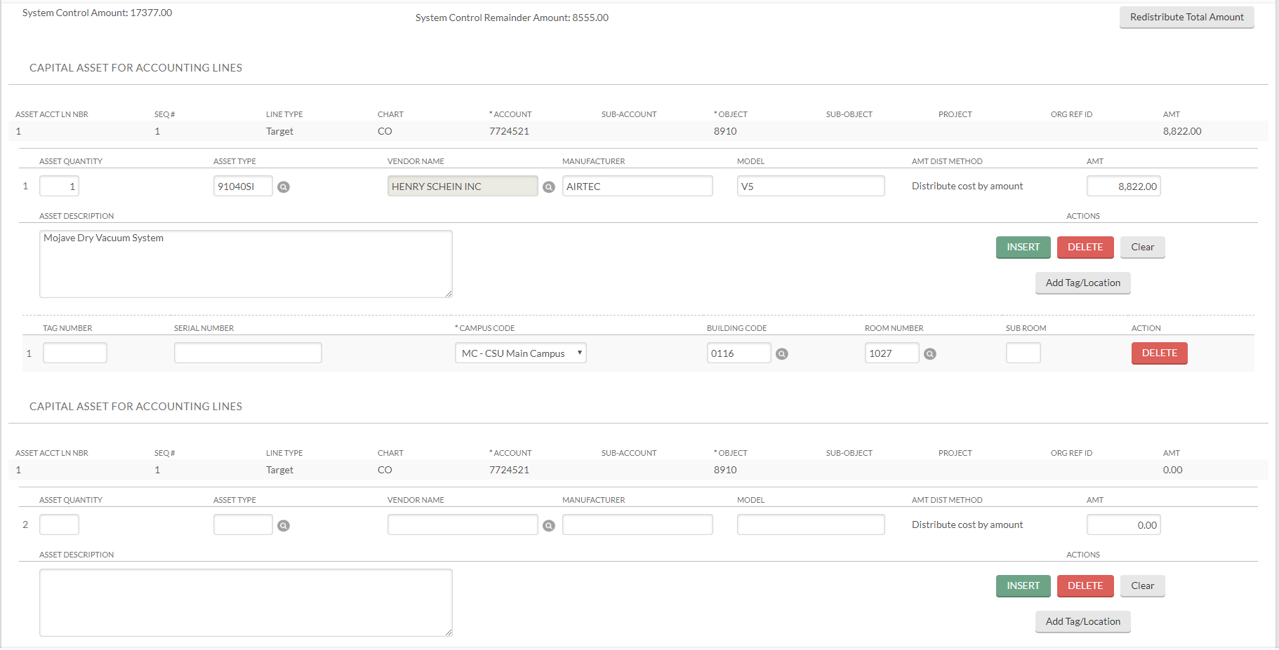
CREATE CAPITAL ASSETS TAB
This will bring up another Capital Asset for Accounting Lines section.

Slide 65
CREATE CAPITAL ASSETS TAB
Enter the following:
Asset Quantity: 1
Asset Type (use the magnifying glass, if needed): 82985SI
Vendor Name (can only be entered by using the magnifying glass):
Lookup “Henry Schein Inc”
Manufacturer: SCICAN
Model: HYDRIM G4
Amount (since Distribute cost by amount was selected): $8,555.00
Asset Description: Large Instrument Washer
Click on: “add tag/location”

Slide 66
CREATE CAPITAL ASSETS TAB
The Tag Number and Serial Number may be left blank, however, the Asset Location is required.
Enter the following:
Campus Code: MC
Building Code: 0116
Room Number 1024

Slide 67
CREATE CAPITAL ASSETS TAB
The System Control Remainder Amount should now be 0.00
Notes:
If there is still a balance in the System Control Remaining Amount, click on the button to distribute it.

Slide 68
NOTES AND ATTACHMENTS TAB
Attach any backup in the Notes and Attachments Tab. and click on “add”.
You can now submit, save, reload, close, cancel, or copy the document.
Click on: “save”.

Slide 69
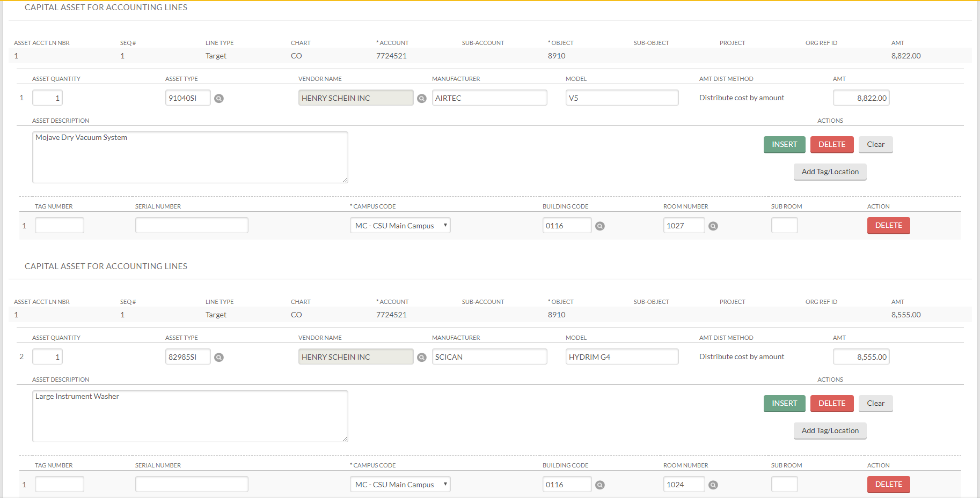
MAKING CHANGES
Capital Asset Tab Changes
You may make changes in areas that have “Action” buttons.
You can delete tag information, insert or add another line item, delete the line, or clear the line.
Notes:
Insert and Add/Tag Location must equal the Asset Quantity (i.e. only 2 assets, you will only be able to insert or add for 2 assets).

Slide 70
MAKING CHANGES
To add another asset, it must be identical to the current asset. Change the quantity on line one from “1” to “2”
Click on: “insert” or “add tag/location”

Slide 71
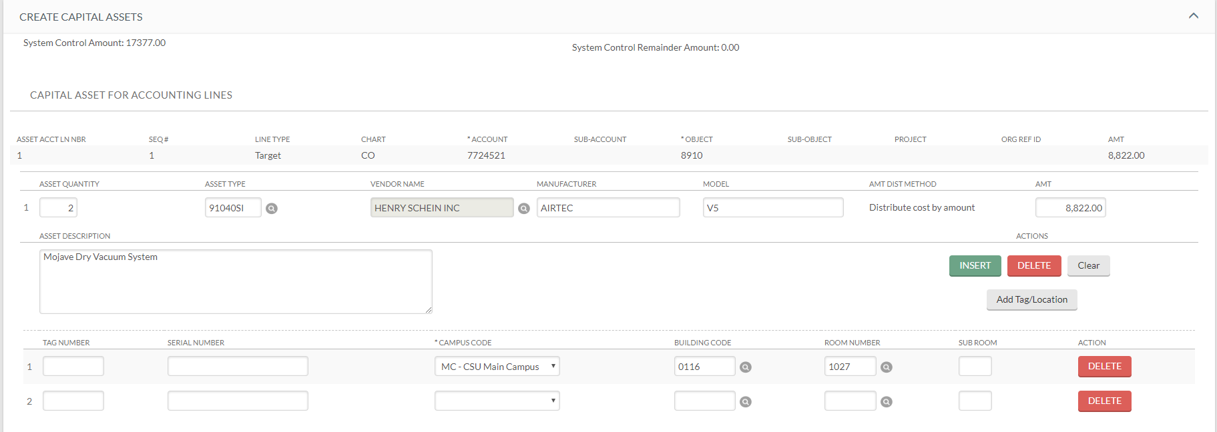
CREATE CAPITAL ASSETS TAB
A second line is brought in to complete.
Enter the following:
Campus Code: MC
Building Code: 0116
Room Number 1027

Slide 72
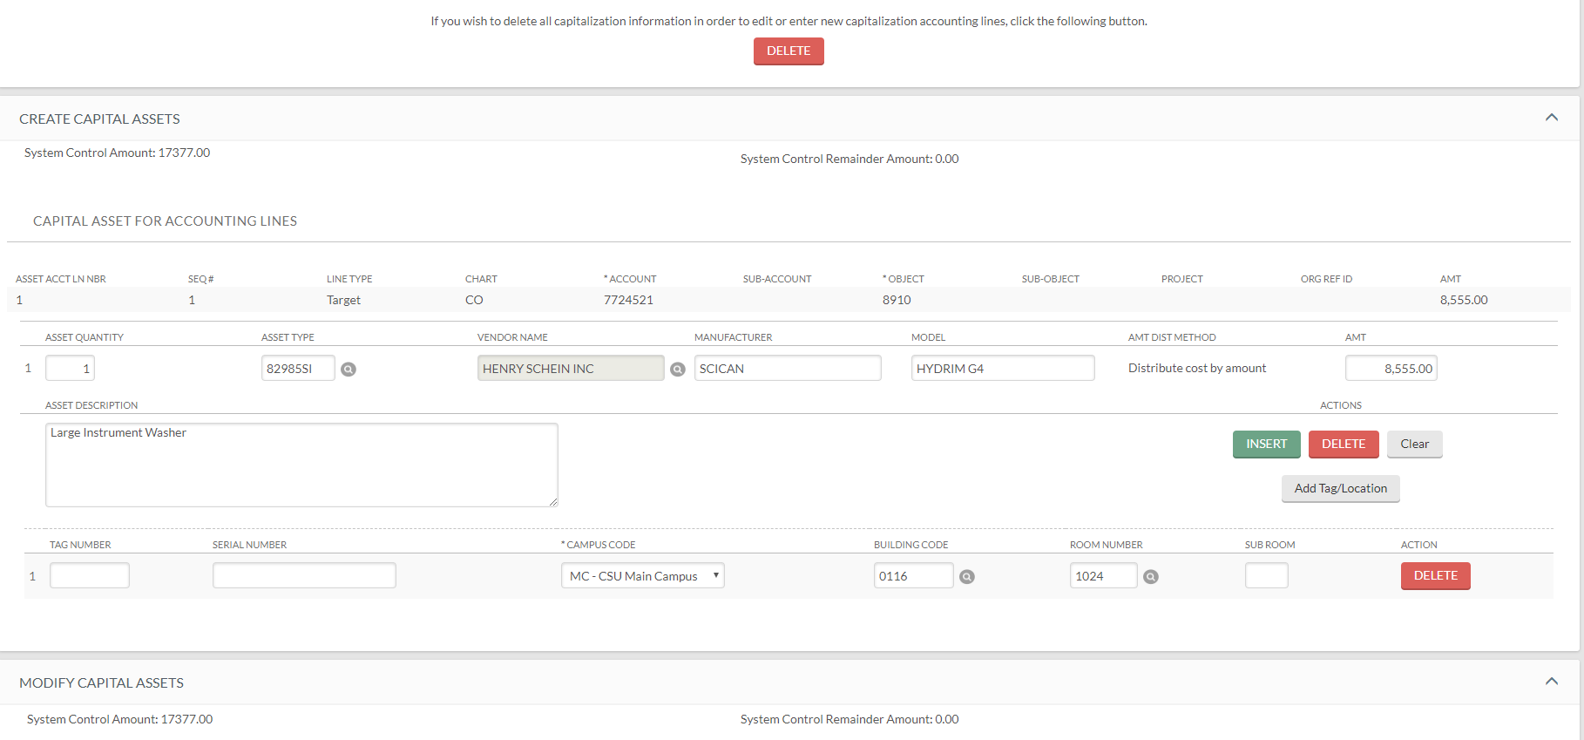
MAKING CHANGES
Accounting Line changes
In order to make any accounting line changes after opening either the Create Asset or Modify Asset tab, you will need to delete all capital asset information.
Click on: “delete”

Slide 73
MAKING CHANGES
This will delete everything in the Accounting Lines For Capitalization Tab.

Slide 74
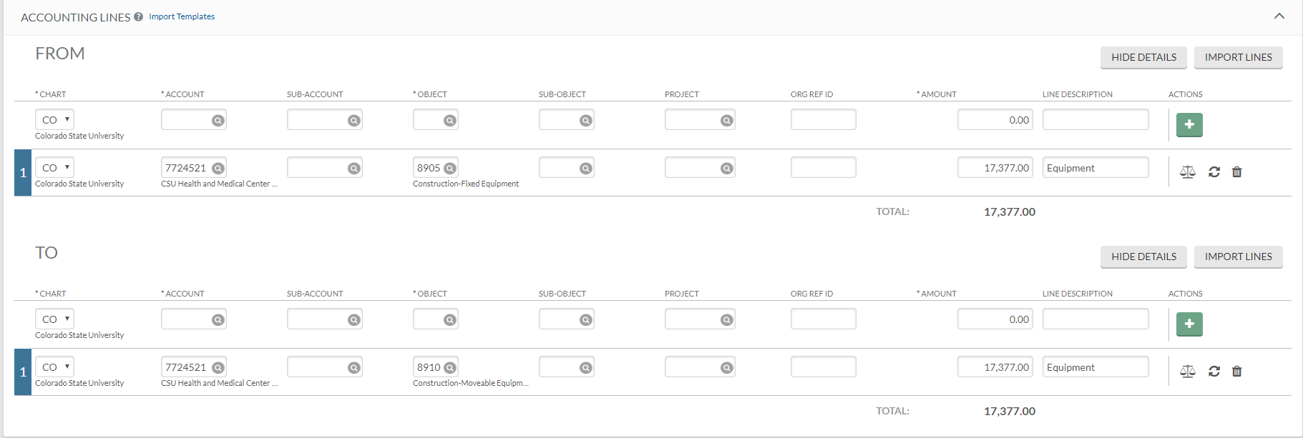
MAKING CHANGES
Accounting Line changes
You can now make the following changes:
Change account numbers, change object codes, change amounts (if you make any of these changes, click on the refresh button to update the view), add additional lines, or delete lines.

Slide 75
QUESTIONS?

Slide 76
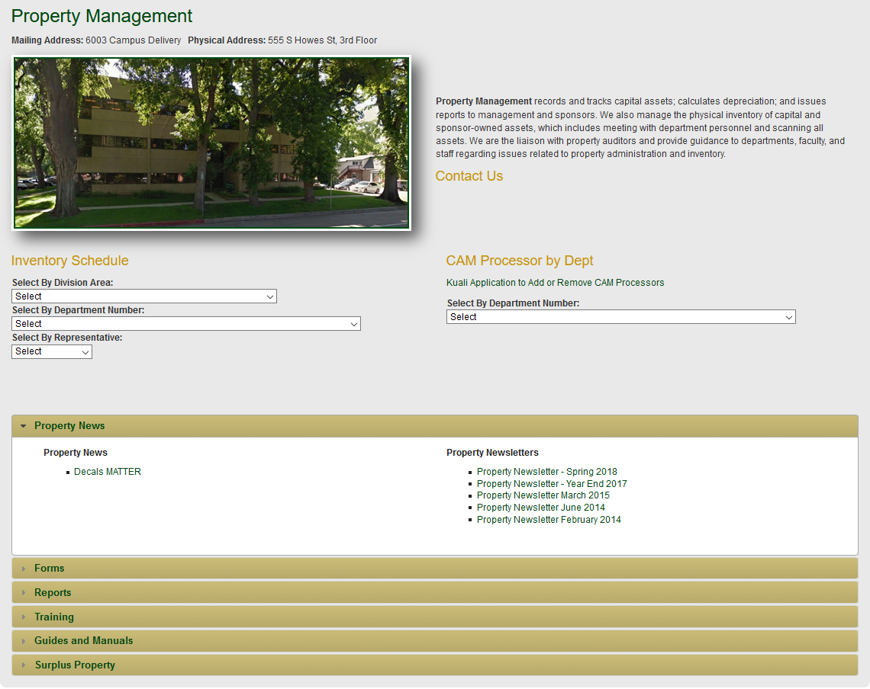
FORMS
REPORTS
TRAINING
REFERENCE
Notes:
You can find a lot of information from the Property Management site. From CSU’s main webpage select P from the A-Z lookup, then click Property Management
To add CAM Processor role for a user go to BFS webpage, Forms, Access Applications and Signature Forms, “Application for Kuali Financial System”; be sure to check the KFS Capital Assets KFS-CAM Processor checkbox

Slide 77
Thank you for watching this presentation by the Property Management Office
491-2899 Jacque Clark – Property Manager / Cost Accountant
491-6513 Laila Dillsi - Leases / Accounting
491- 7362 Cheri Richardson – Accounting
491- 2270 Debra Ellison – Supervisor / Acct Tech III
491-1045 Rachel Drenth – Inventory Specialist / Data Entry
491-1358 Michelle Miller - Inventory Specialist / Data Entry
We are available to help

